Slide 1
Thanks!
to
Lucie, Enzo, and Jackie,
and to Mike for making this visit possible, and so much else

Slide 2
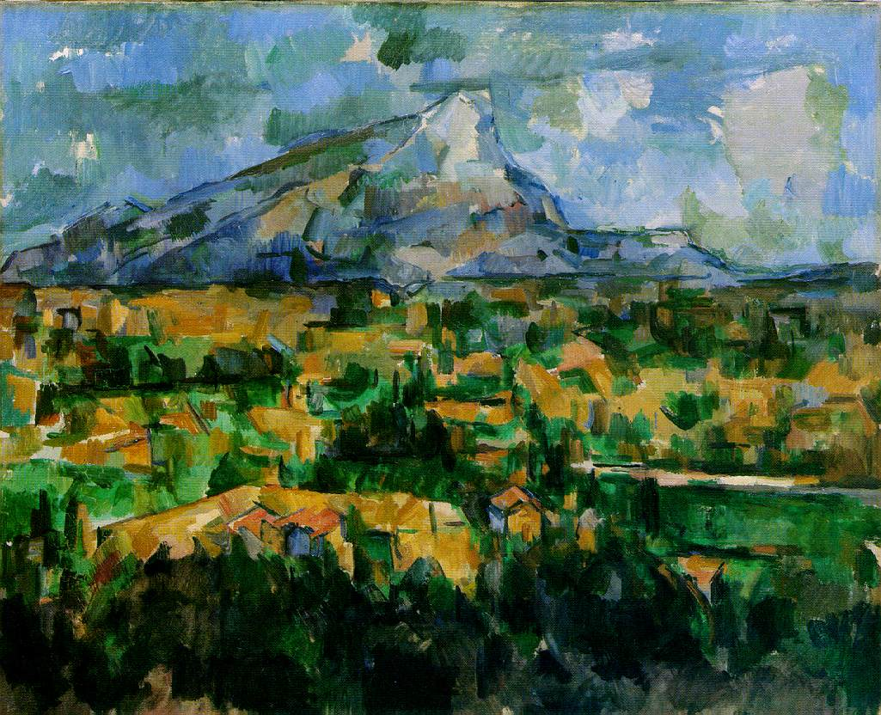

Slide 3

For me (and maybe few others)
Cezanne’s
Mont Sainte-Victoire* vu des Lauves
is a
Miracle
*one of two at Philadelphia Museum of Art

Slide 4
And its fraternal twin
(i.e., not identical)
in the Philadelphia Museum of Art
it is worth a visit,
and see the Barnes as well

Slide 5
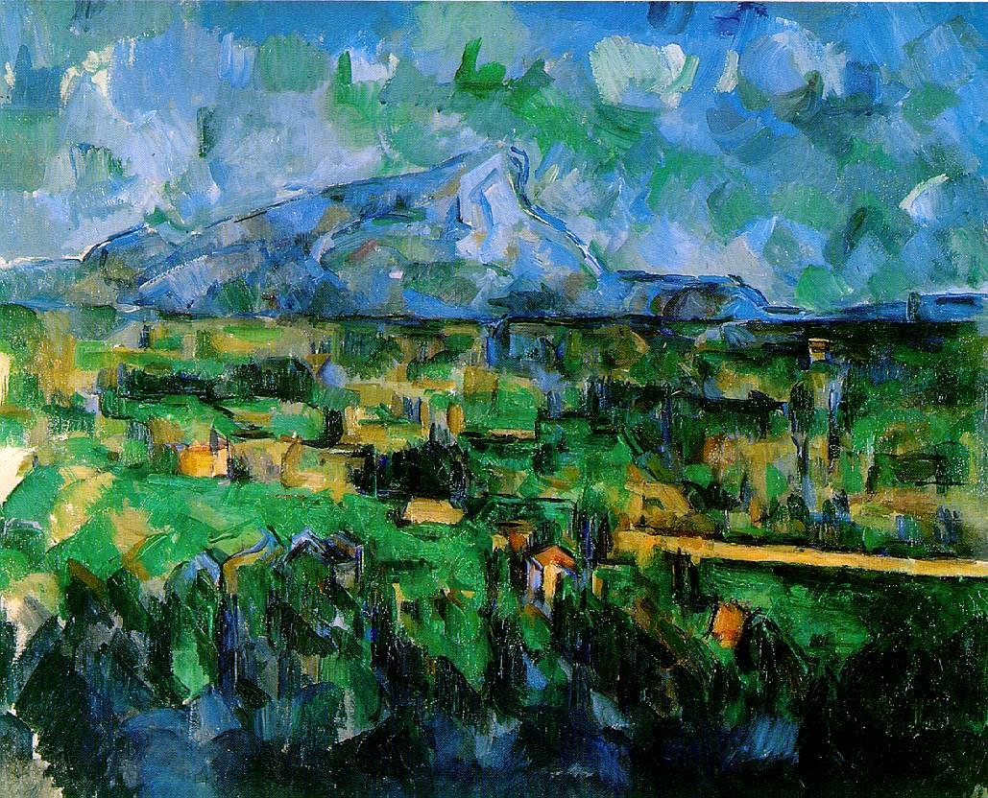

Slide 6
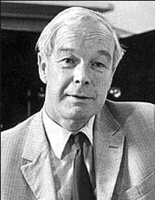
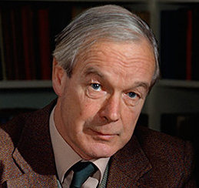
Device Approach to Biology is also a
Miracle
Alan Hodgkin friendly
Alan Hodgkin:
“Bob, I would not put it that way”

Slide 7
Take Home Lesson
Biology
is all about
Dimensional Reduction
to a
Reduced Model
of a
Device

Slide 8
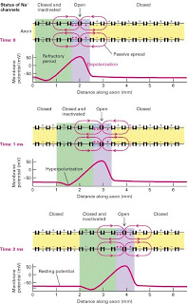
Biology is made of Devices and they are Multiscale
Hodgkin’s Action Potential
is the Ultimate Biological Device
from Input from Synapse Output to Spinal Cord
Ultimate Multiscale Device
from Atoms to Axons
Ångstroms to Meters

Slide 9
Device
Amplifier Converts an Input to an Output
by a simple ‘law’
an algebraic equation
V_{in}
Gain
V_{out}
Power Supply
110 v

Slide 10
Device
converts an Input to an Output
by a simple ‘law’
DEVICE IS USEFUL because it is ROBUST and TRANSFERRABLE
g_{gain} is Constant !!

Slide 11
Device
Amplifier Converts an Input to an Output
V_{in}
Gain
V_{out}
Power Supply
110 v
Input, Output, Power Supply are at Different Locations Spatially non-uniform boundary conditions
Power is needed Non-equilibrium, with flow
Displaced Maxwellian is enough to provide the flow

Slide 12
Device
Amplifier Converts an Input to an Output
V_{in}
Gain
V_{out}
Power Supply
110 v
Power is needed Non-equilibrium, with flow
Displaced Maxwellian of velocities Provides Flow
Input, Output, Power Supply are at Different Locations Spatially non-uniform boundary conditions

Slide 13
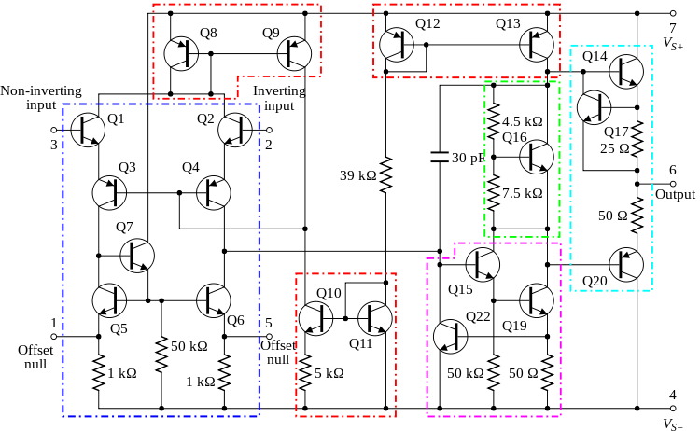
Device converts Input to Output by a simple ‘law’
Device is ROBUST and TRANSFERRABLE
because it uses POWER and has complexity!
Circuit Diagram of common 741 op-amp: Twenty transistors needed to make linear robust device
Power Supply
INPUT V_{in} (t)
OUTPUT V_{out} (t)
Power Supply
Dirichlet Boundary Condition
independent of time
and everything else
Dotted lines outline: current mirrors (red); differential amplifiers (blue); class A gain stage (magenta); voltage level shifter (green); output stage (cyan).

Slide 14
How do a few atoms control (macroscopic) Device Function ?
Mathematics of Molecular Biology
is about How does the device work?

Slide 15
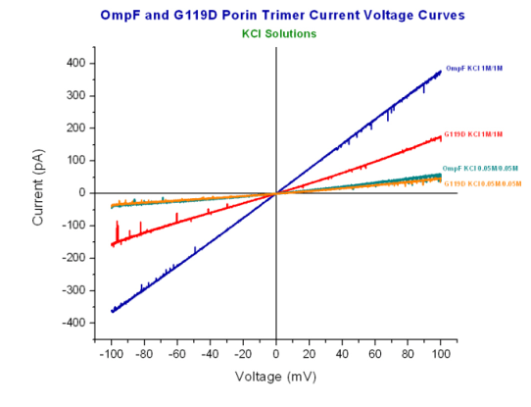
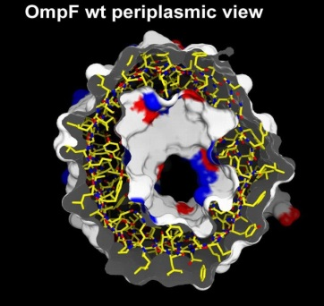
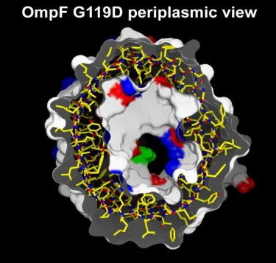
A few atoms make a BIG Difference
Glycine G replaced by Aspartate D
Ompf
OmpF 1M/1M
G119D 1M/1M
OmpF 0.05M/0.05M
G119D 0.05M/0.05M
G119D
Current Voltage relation determined by John Tang in Bob Eisenberg’s Lab
Structure determined by Raimund Dutzler in Tilman Schirmer’s lab

Slide 16
Multiscale Analysis is Inevitable
because a Few Atoms
Ångstroms
control Macroscopic Function
centimeters

Slide 17
Mathematics Must Include Structure and Function
Atomic Space = Ångstroms
Atomic Time = 10⁻¹⁵ sec
Cellular Space = 10⁻² meters
Cellular Time = Milliseconds
Variables that are the function,
like Concentration, Flux, Current

Slide 18
Mathematics Must Include Structure and Function
Variables of Function
are Concentration
Flux
Membrane Potential
Current

Slide 19
Mathematics must be accurate
There is no engineering without numbers
and the numbers must be accurate!

Slide 20
Cannot build a box without accurate numbers!!

Slide 21
CALIBRATED simulations are needed just as calibrated measurements
and calculations are needed
Calibrations must be of simulations of activity measured
experimentally, i.e., free energy per mole.
Fortunately, extensive measurements are available

Slide 22
FACTS
(1) Atomistic Simulations of Mixtures are extraordinarily difficult
because all interactions must be computed correctly
(2) All of life occurs in ionic mixtures
like Ringer solution
(3) No calibrated simulations of Ca²⁺ are available.
because almost all the atoms present
are water, not ions.
No one knows how to do them.
(4) Most channels, proteins, enzymes, and nucleic acids change significantly when [Ca²⁺] changes
from its background concentration 10⁻⁸M ion.

Slide 23
CONCLUSIONS
Multiscale Analysis is REQUIRED in Biological Systems
Simulations cannot easily deal with Biological Reality

Slide 24
Scientists must Grasp and not just reach.
That is why calibrations are necessary.
Poets hope we will never learn the difference between dreams and realities
“Ah, … a man's reach should exceed his grasp, Or what's a heaven for?”
Robert Browning
"Andrea del Sarto", line 98.

Slide 25
Mathematics describes only a little of Daily Life
But Mathematics* Creates our Standard of Living
*e.g., Electricity, Computers, Fluid Dynamics, Optics, Structural Mechanics, …..

Slide 26
Mathematics Creates our Standard of Living Mathematics replaces Trial and Error with Computation
*e.g., Electricity, Computers, Fluid Dynamics, Optics, Structural Mechanics, …..

Slide 27
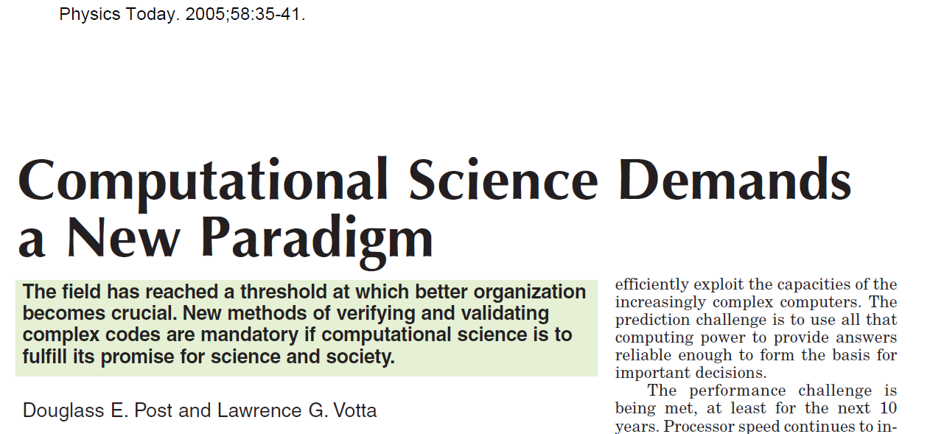
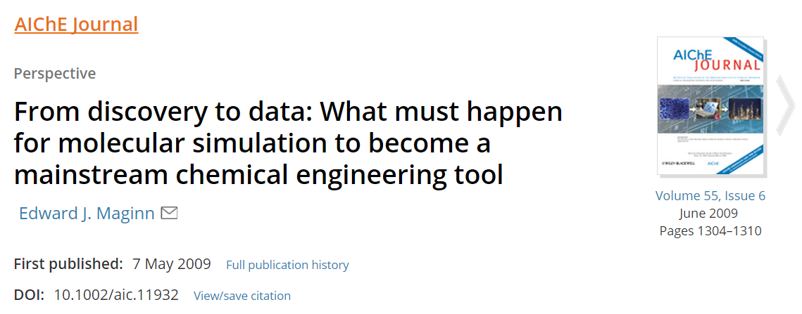
Physics Today 58:35
*
Calibration!
*not so new, really, just unpleasant

Slide 28
Mathematics is Needed to Describe and Understand Devices of Biology and Technology

Slide 29
How can we use mathematics to describe biological systems?
I believe some biology is Physics ‘as usual’ ‘Guess and Check’
But you have to know which biology!

Slide 30
Device Approach
enables
Dimensional Reduction
to a
Device Equation
which tells
How it Works

Slide 31
DEVICE APPROACH IS FEASIBLE
Biology Provides the Data
Semiconductor Engineering Provides the Approach Mathematics Provides the Tools

Slide 32
Mathematics of Molecular Biology
Must be Multiscale because a few atoms
Control Macroscopic Function

Slide 33
Mathematics of Molecular Biology
Nonequilibrium because Devices need Power Supplies
to
Control Macroscopic Function

Slide 34

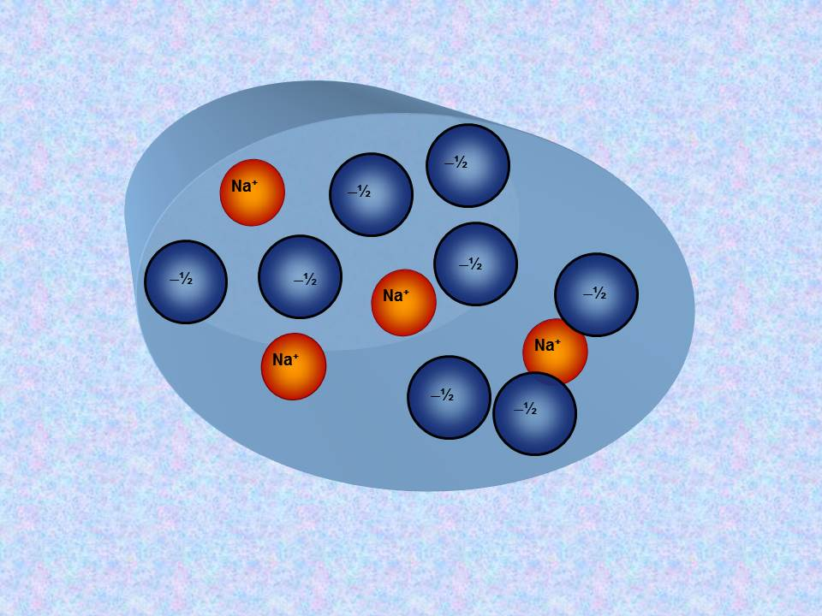
‘All Spheres’ Model
Side Chains are Spheres
Channel is a Cylinder
Side Chains are free to move within Cylinder
Ions and Side Chains are at free energy minimum
i.e., ions and side chains are ‘self organized’,
‘Binding Site” is induced by substrate ions
Nonner & Eisenberg

Slide 35
Ions in Channels
and
Ions in Bulk Solutions
are
Complex Fluids like liquid crystals of LCD displays
All atom simulations of complex fluid are particularly challenging because
‘Everything’ interacts with ‘everything’ else
on atomic & macroscopic scales

Slide 36
Central Result of Physical Chemistry
Ions in a solution are a Highly Compressible Plasma
although the Solution is Incompressible
Free energy of an ionic solution is mostly determined by the Number density of the ions. Density varies from 10⁻¹¹ to 10¹M in typical biological system of proteins, nucleic acids, and channels.
Learned from Doug Henderson, J.-P. Hansen, Stuart Rice, among others…Thanks!

Slide 37
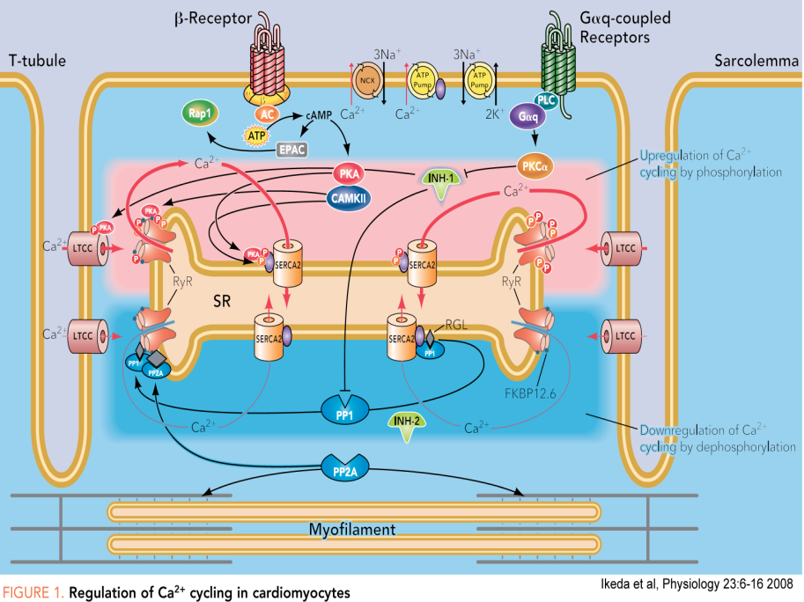
All Spheres Models work well for Calcium and Sodium Channels
Nerve
Skeletal muscle
Heart Muscle Cell

Slide 38
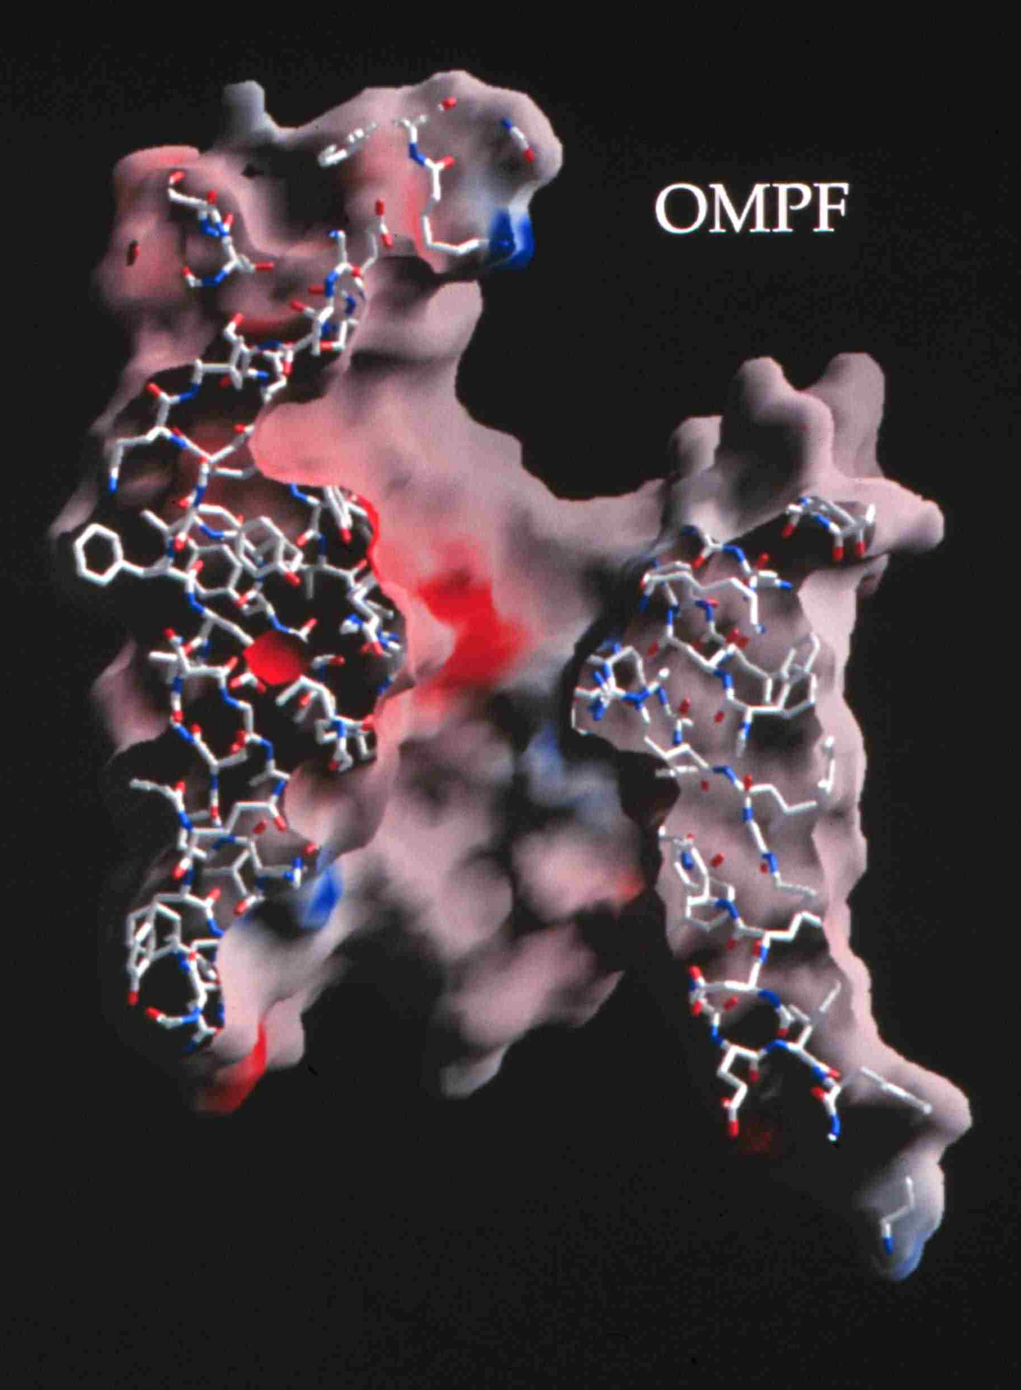
Natural nano-valves** for atomic control of biological function
Ion Channels: Biological Devices, Diodes*
Ion channels coordinate contraction of cardiac muscle, allowing the heart to function as a pump
Coordinate contraction in skeletal muscle
Control all electrical activity in cells Produce signals of the nervous system
Are involved in secretion and absorption in all cells: kidney, intestine, liver, adrenal glands, etc.
Are involved in thousands of diseases and many drugs act on channels
Are proteins whose genes (blueprints) can be manipulated by molecular genetics
Have structures shown by x-ray crystallography in favorable cases
Can be described by mathematics in some cases
K⁺
~30 x 10⁻⁹ meter
*Device is a Specific Word, that exploits specific mathematics & science
*nearly pico-valves: diameter is 400 – 900 x 10⁻¹² meter; diameter of atom is ~200 x 10⁻¹² meter
Notes:
Ion channels are a class of Proteins that reside in the cell membrane of all biological cells. Each channel protein consists of a chain of amino acids folded in such a way that it forms a nanoscopic water-filled tunnel through which ions can flow to cross the otherwise impermeable membrane.
Every ion channel carries a strong and steeply varying distribution of permanent charge, which depends on the particular combination of channel and prevalent physiological conditions. This permanent charge has an important role in determining the current-voltage characteristics of the open channel.
Many channels are designed by nature to selectively transmit or block a particular ion species. This allows only one type of ion to cross the membrane even though other ions may be present in much higher concentrations. Many channels can also open and close by mechanical or other means, switching on and off like electronic devices.
From a physiological point of view ion channels are essential for maintaining the correct internal ion composition necessary for cell survival and function. They directly control electrical signaling in the nervous system, muscle contraction, and the delivery of many clinical drugs. Malfunctioning channels cause or are associated with many diseases.
From a device point of view, ion channels can be thought of as elements in an electrical circuit, behaving like resistors, diodes or batteries depending on the specific channel and environmental factors. By replacing or deleting one or more of the amino acids many channels can be mutated, altering the charge distribution along the channel. Designing and engineering channels with specific conductances and selectivities, and incorporating them into bio-devices, is a real possibility.

Slide 39
Evidence
RyR
(start)

Slide 40
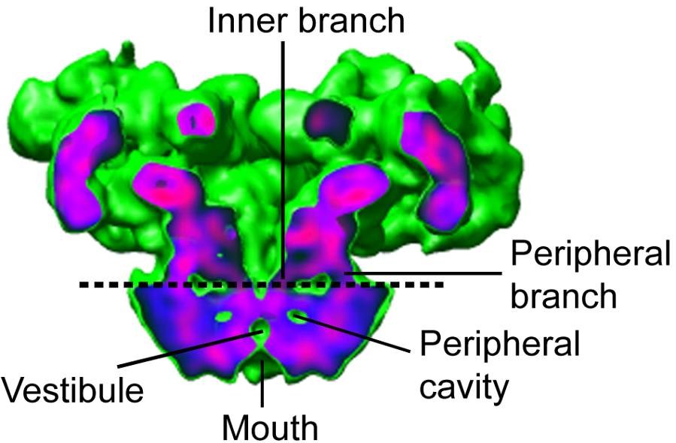
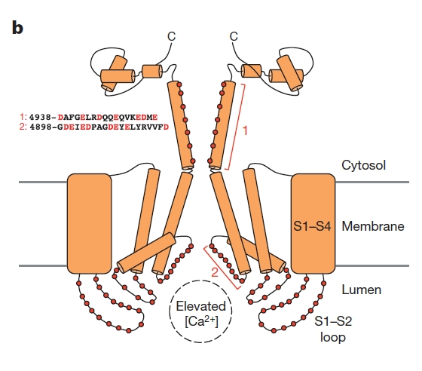
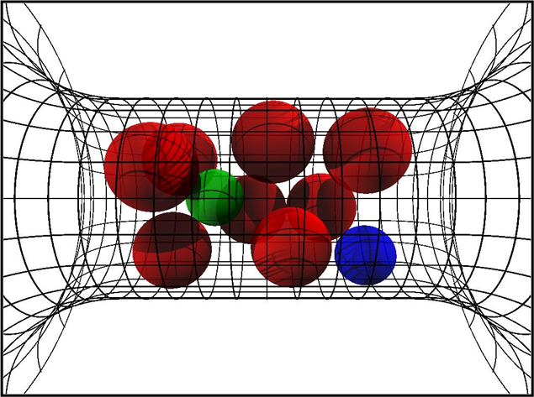
RyR Ryanodine Receptor redrawn in part from Dirk Gillespie, with thanks!
Samsó et al, 2005, Nature Struct Biol 12: 539
Zalk, et al 2015 Nature 517: 44-49.
All Spheres Representation
4 negative charges D4899
Cylinder 10 Å long, 8 Å diameter
13 M of charge!
18% of available volume
Very Crowded!
Four lumenal E4900 positive amino acids overlapping D4899.
Cytosolic background charge

Slide 41
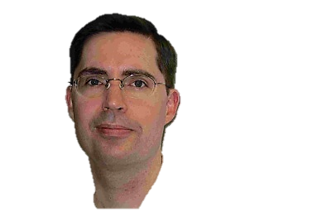
Best Evidence is from the
RyR Receptor
Dirk Gillespie Dirk_Gillespie@rush.edu
Gerhard Meissner, Le Xu, et al, not Bob Eisenberg
● More than 120 combinations of solutions & mutants
● 7 mutants with significant effects fit successfully

Slide 42
1. Gillespie, D., Energetics of divalent selectivity in a calcium channel: the ryanodine receptor case study. Biophys J, 2008. 94(4): p. 1169-1184.
2. Gillespie, D. and D. Boda, Anomalous Mole Fraction Effect in Calcium Channels: A Measure of Preferential Selectivity. Biophys. J., 2008. 95(6): p. 2658-2672.
3. Gillespie, D. and M. Fill, Intracellular Calcium Release Channels Mediate Their Own Countercurrent: Ryanodine Receptor. Biophys. J., 2008. 95(8): p. 3706-3714.
4. Gillespie, D., W. Nonner, and R.S. Eisenberg, Coupling Poisson-Nernst-Planck and Density Functional Theory to Calculate Ion Flux. Journal of Physics (Condensed Matter), 2002. 14: p. 12129-12145.
5. Gillespie, D., W. Nonner, and R.S. Eisenberg, Density functional theory of charged, hard-sphere fluids. Physical Review E, 2003. 68: p. 0313503.
6. Gillespie, D., Valisko, and Boda, Density functional theory of electrical double layer: the RFD functional. Journal of Physics: Condensed Matter, 2005. 17: p. 6609-6626.
7. Gillespie, D., J. Giri, and M. Fill, Reinterpreting the Anomalous Mole Fraction Effect. The ryanodine receptor case study. Biophysical Journal, 2009. 97: p. pp. 2212 - 2221
8. Gillespie, D., L. Xu, Y. Wang, and G. Meissner, (De)constructing the Ryanodine Receptor: modeling ion permeation and selectivity of the calcium release channel. Journal of Physical Chemistry, 2005. 109: p. 15598-15610.
9. Gillespie, D., D. Boda, Y. He, P. Apel, and Z.S. Siwy, Synthetic Nanopores as a Test Case for Ion Channel Theories: The Anomalous Mole Fraction Effect without Single Filing. Biophys. J., 2008. 95(2): p. 609-619.
10. Malasics, A., D. Boda, M. Valisko, D. Henderson, and D. Gillespie, Simulations of calcium channel block by trivalent cations: Gd(3+) competes with permeant ions for the selectivity filter. Biochim Biophys Acta, 2010. 1798(11): p. 2013-2021.
11. Roth, R. and D. Gillespie, Physics of Size Selectivity. Physical Review Letters, 2005. 95: p. 247801.
12. Valisko, M., D. Boda, and D. Gillespie, Selective Adsorption of Ions with Different Diameter and Valence at Highly Charged Interfaces. Journal of Physical Chemistry C, 2007. 111: p. 15575-15585.
13. Wang, Y., L. Xu, D. Pasek, D. Gillespie, and G. Meissner, Probing the Role of Negatively Charged Amino Acid Residues in Ion Permeation of Skeletal Muscle Ryanodine Receptor. Biophysical Journal, 2005. 89: p. 256-265.
14. Xu, L., Y. Wang, D. Gillespie, and G. Meissner, Two Rings of Negative Charges in the Cytosolic Vestibule of T Ryanodine Receptor Modulate Ion Fluxes. Biophysical Journal, 2006. 90: p. 443-453.

Slide 43
Solved by DFT-PNP (Poisson Nernst Planck)
DFT-PNP
gives location
of Ions and ‘Side Chains’
as OUTPUT
Other methods give nearly identical results
DFT (Density Functional Theory of fluids, not electrons)
MMC (Metropolis Monte Carlo))
SPM (Primitive Solvent Model)
EnVarA (Energy Variational Approach)
Non-equil MMC (Boda, Gillespie) several forms
Steric PNP (simplified EnVarA)
Poisson Fermi (replacing Boltzmann distribution)

Slide 44
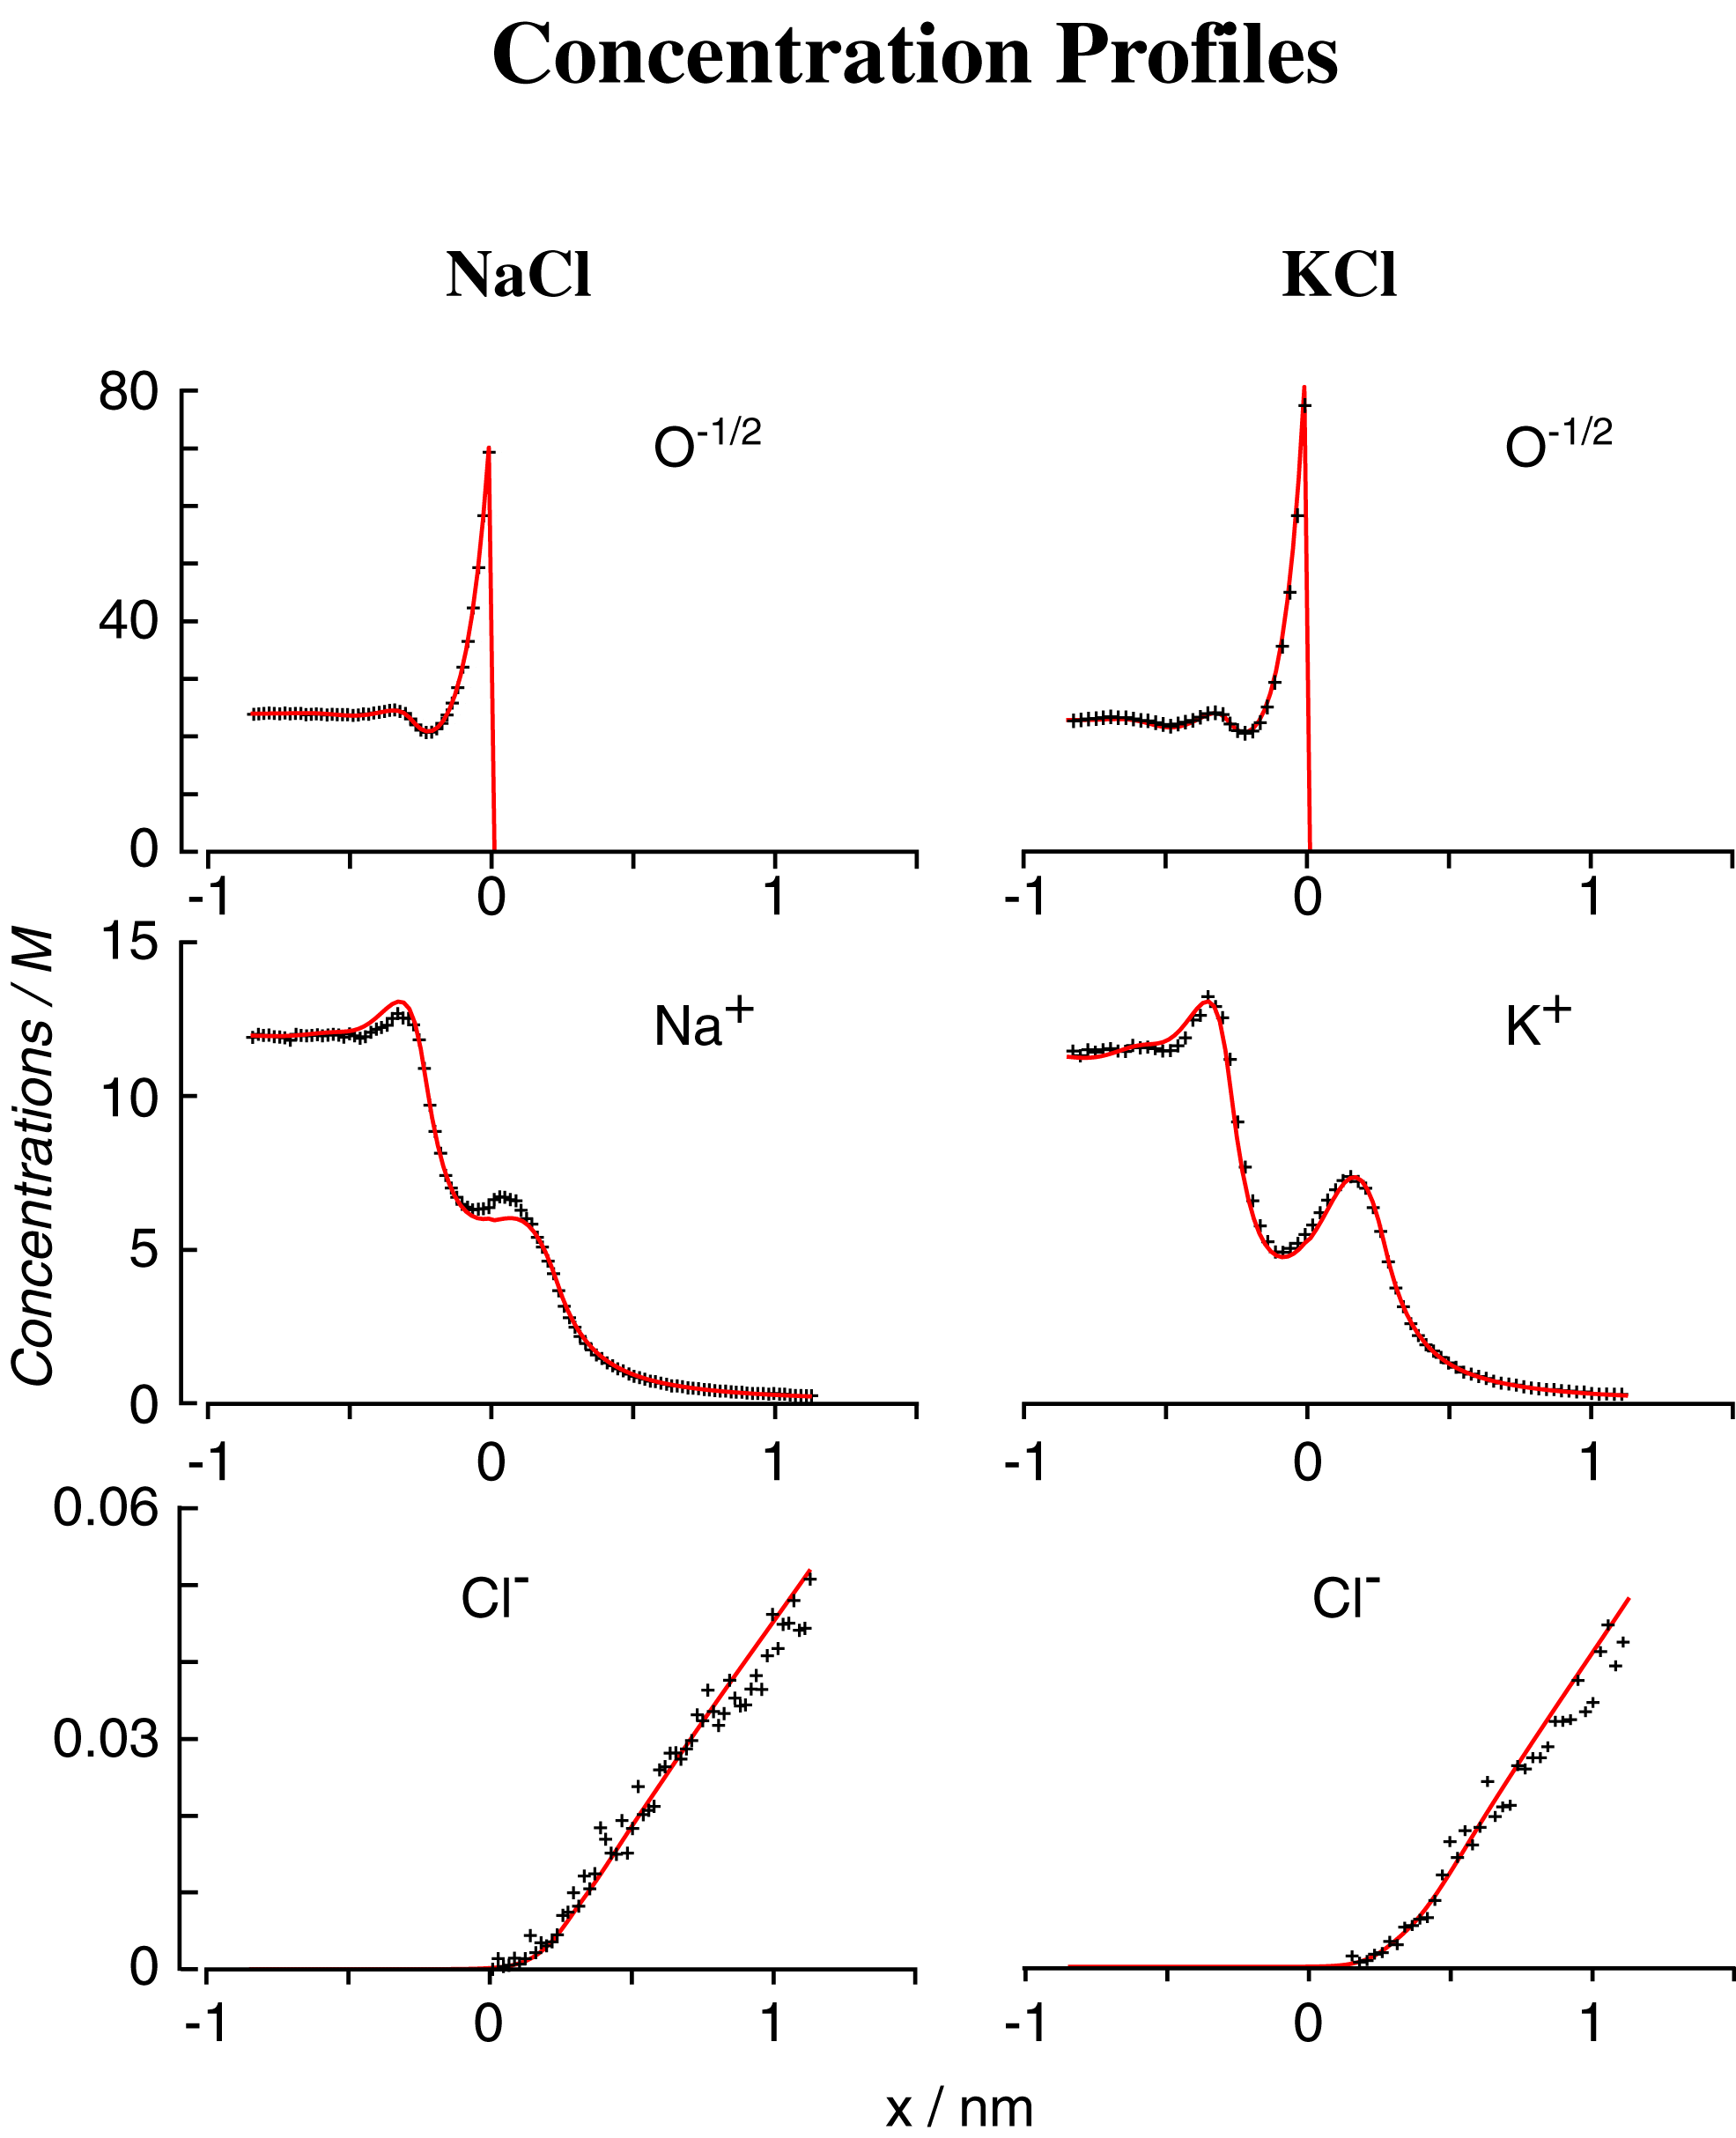
DFT/PNP vs Monte Carlo Simulations
Concentration Profiles
Different Methods give Same Results
NO adjustable parameters
Misfit
Nonner, Gillespie, Eisenberg

Slide 45
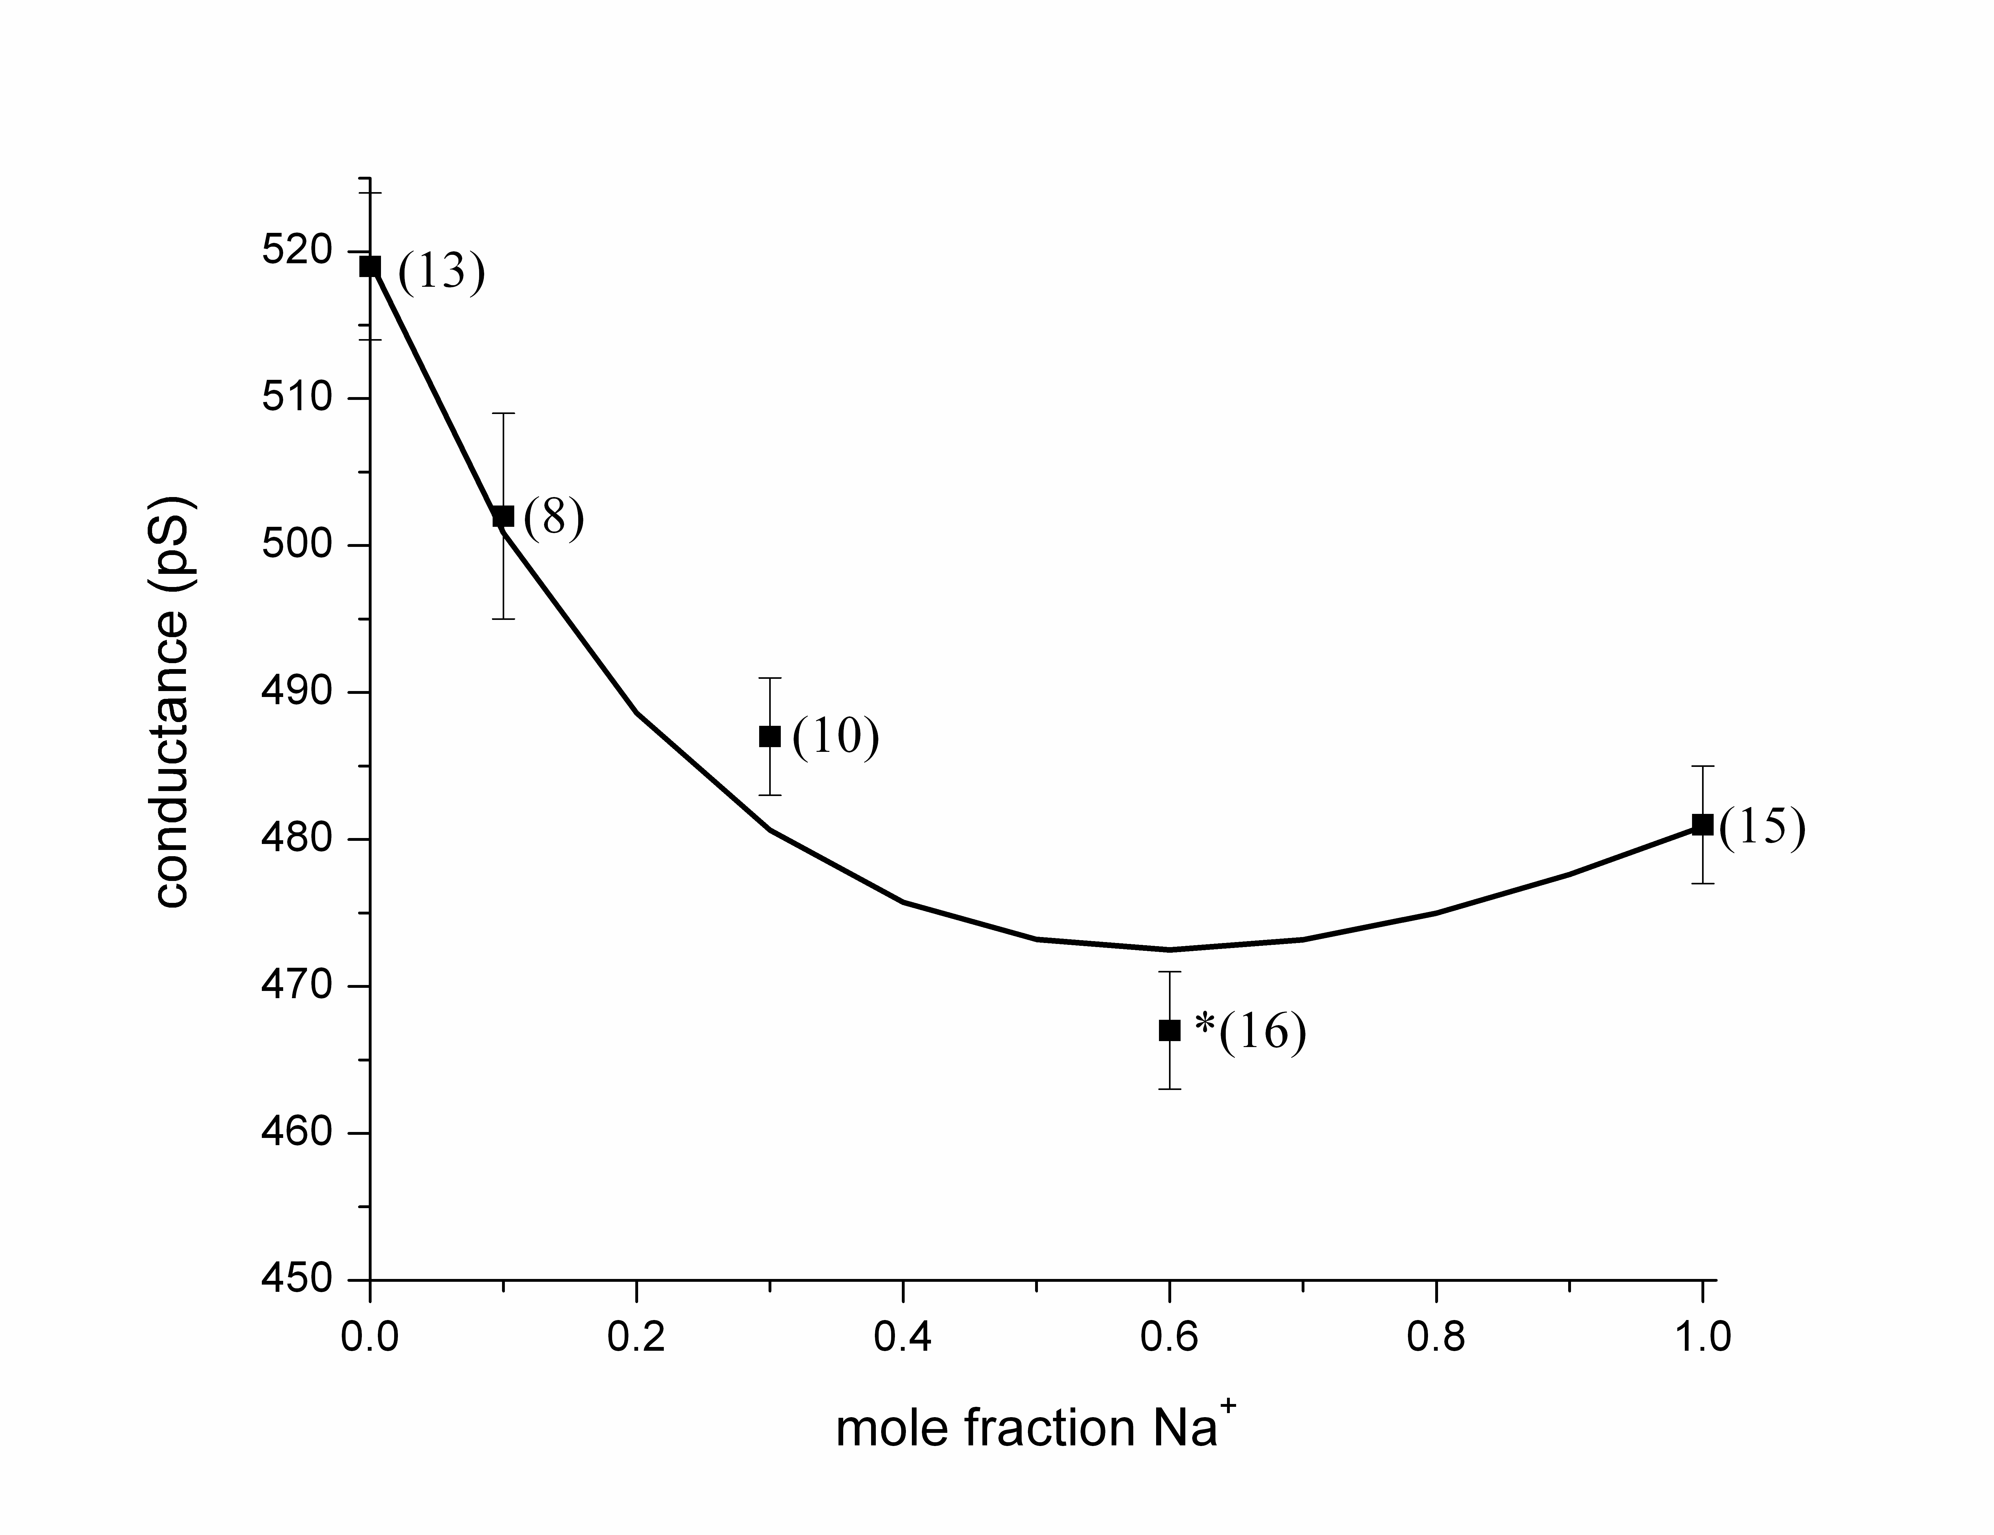
The model predicted an AMFE for Na⁺/Cs⁺ mixtures before it had been measured
62 measurements Thanks to Le Xu!
Mean ± Standard Error of Mean
Note the Scale
2% error
Note the Scale
Gillespie, Meissner, Le Xu, et al

Slide 46
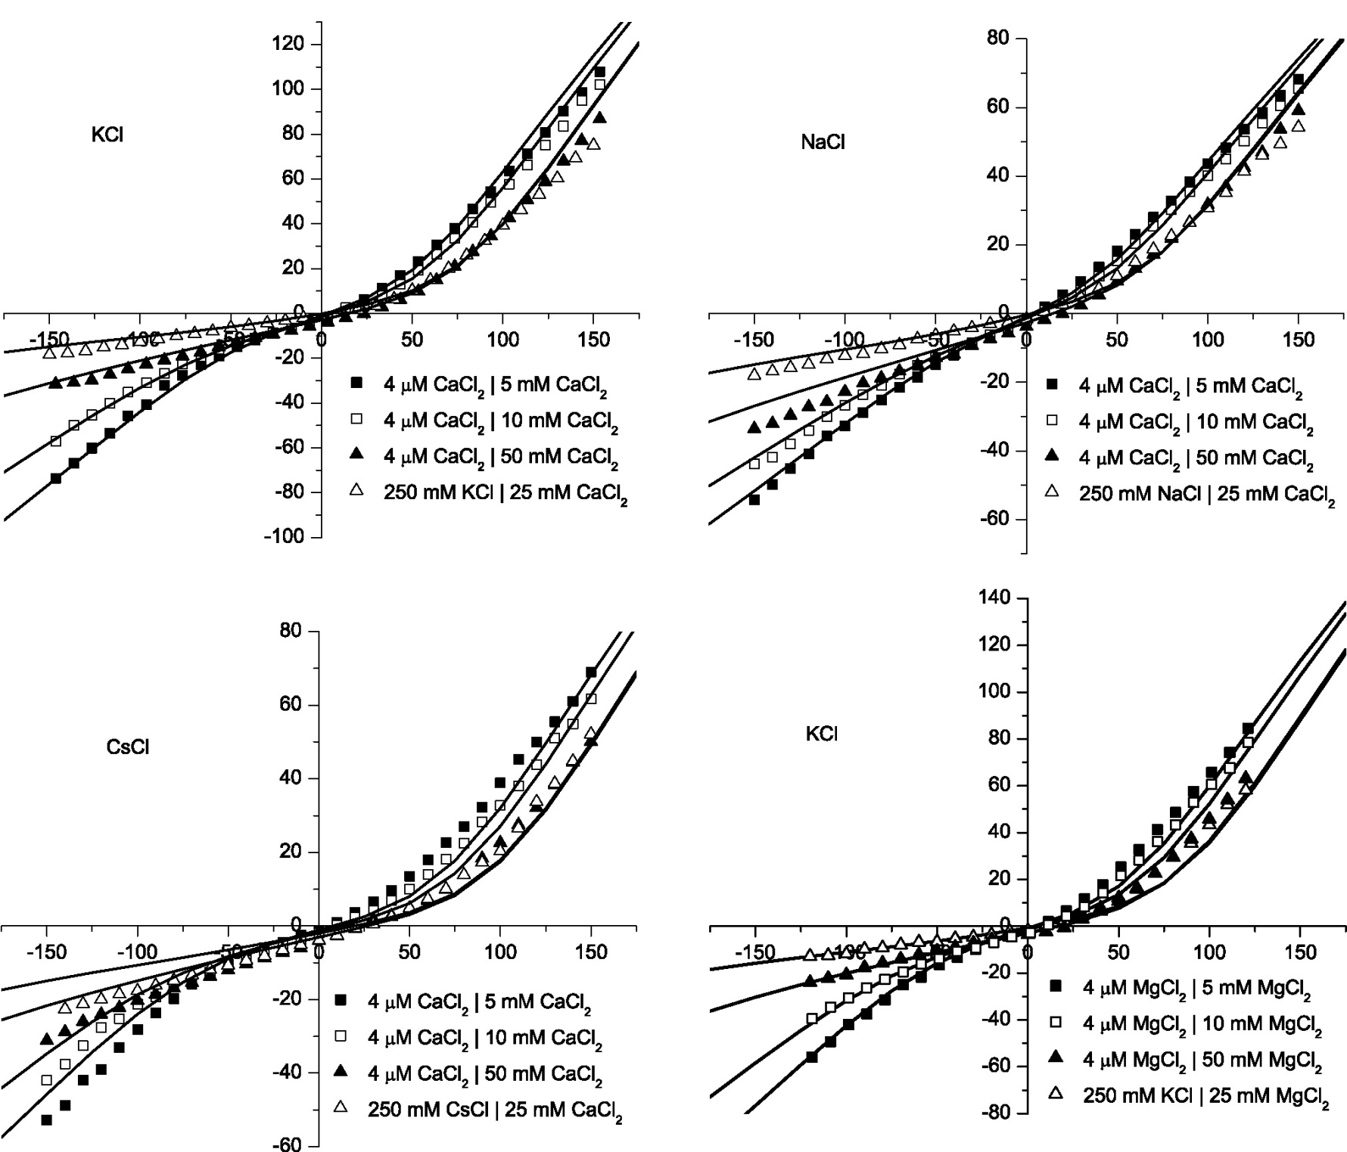
Divalents
KCl
CaCl₂
NaCl
CaCl₂
Misfit
CsCl
CaCl₂
KCl
MgCl₂
Misfit

Slide 47
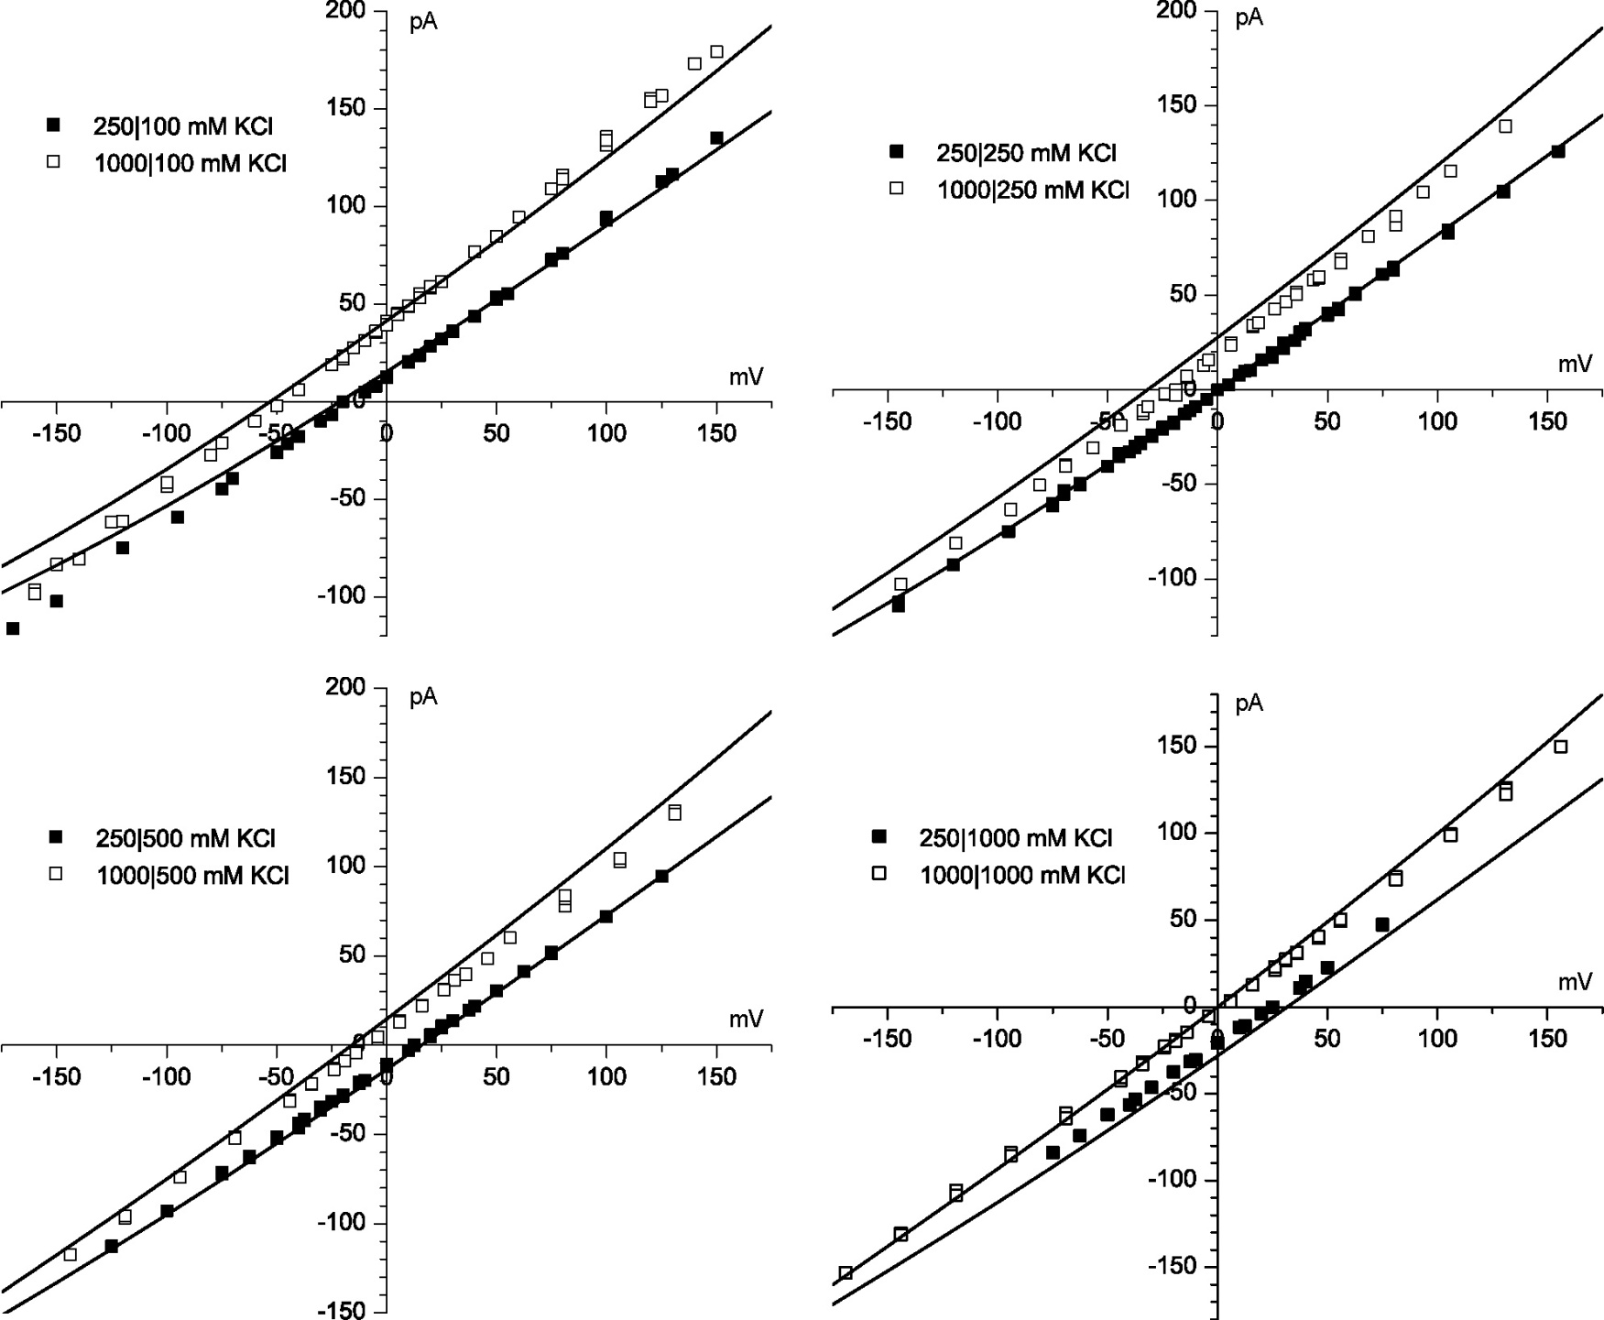
KCl
Gillespie, Meissner, Le Xu, et al
4 kT/e
Error < 0.1 kT/e
Misfit

Slide 48
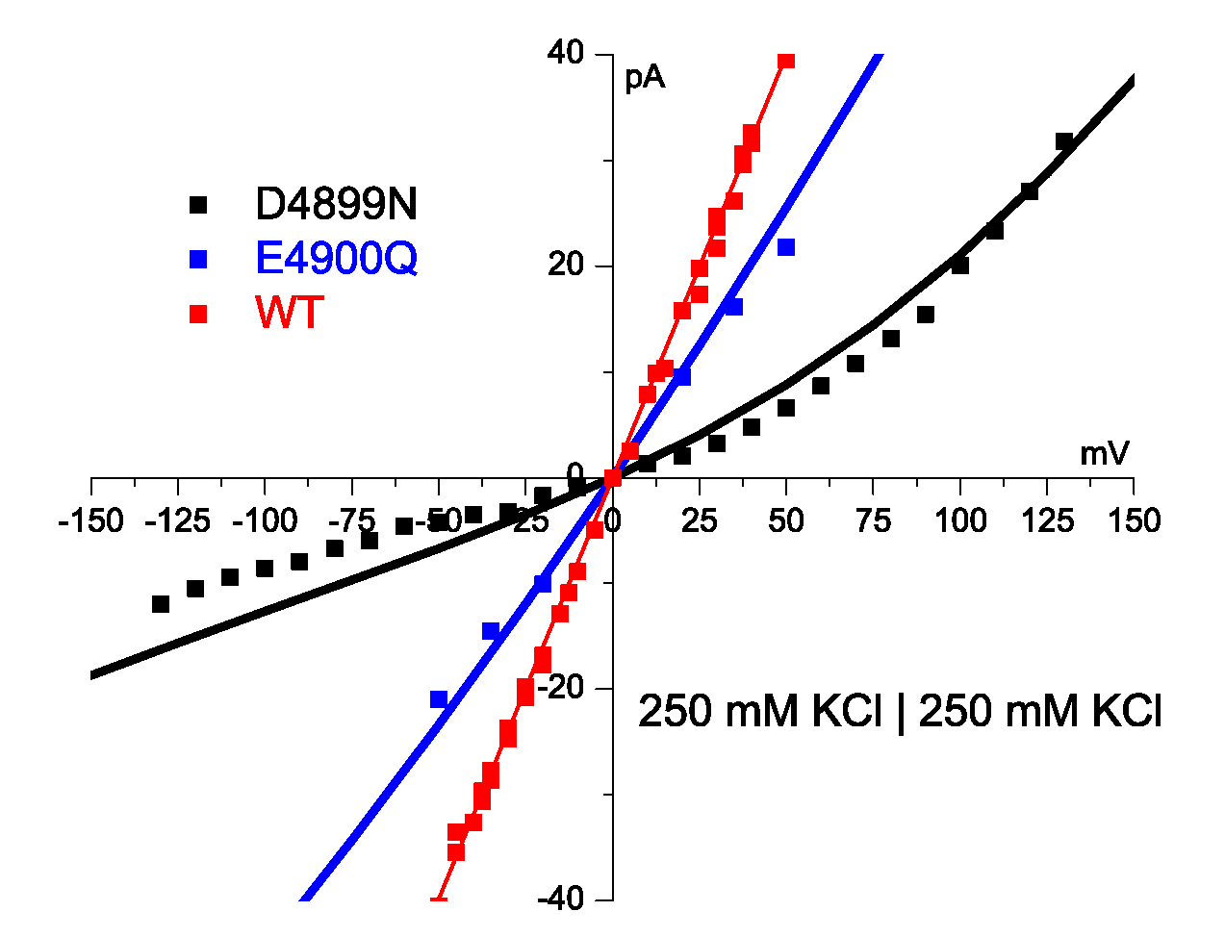
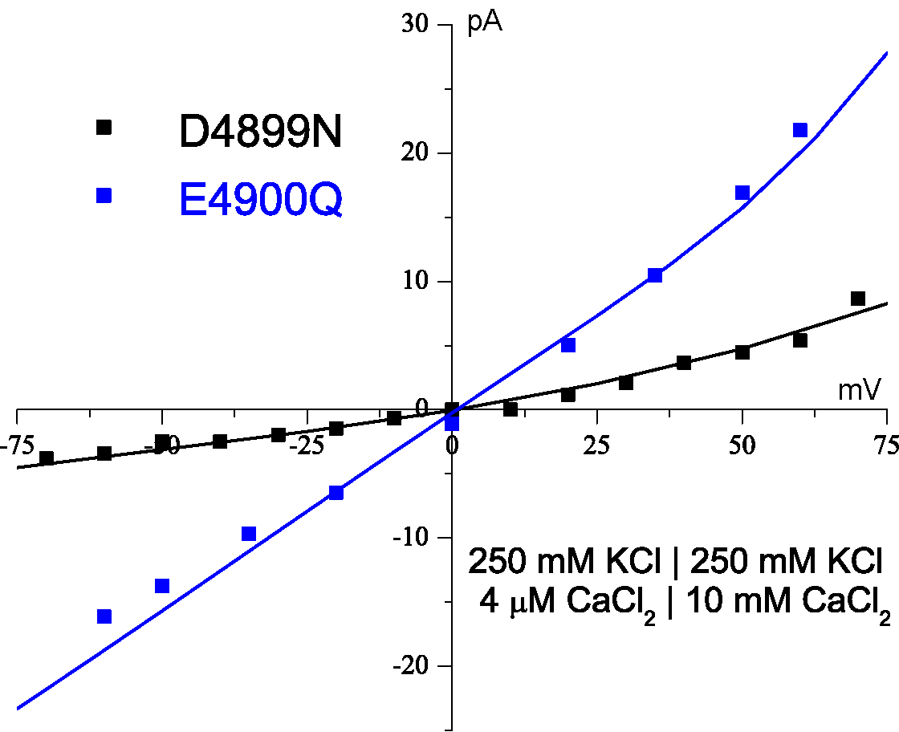
Theory fits Mutation with Zero Charge
Theory Fits Mutant in K
Theory Fits Mutant in K + Ca
Error < 0.1 kT/e
1 kT/e
Protein charge density wild type* 13 M
Solid Na⁺Cl⁻ is 37 M
*some wild type curves not shown, ‘off the graph’
⇨
0 M in D4899
1 kT/e
Gillespie et al J Phys Chem 109 15598 (2005)

Slide 49
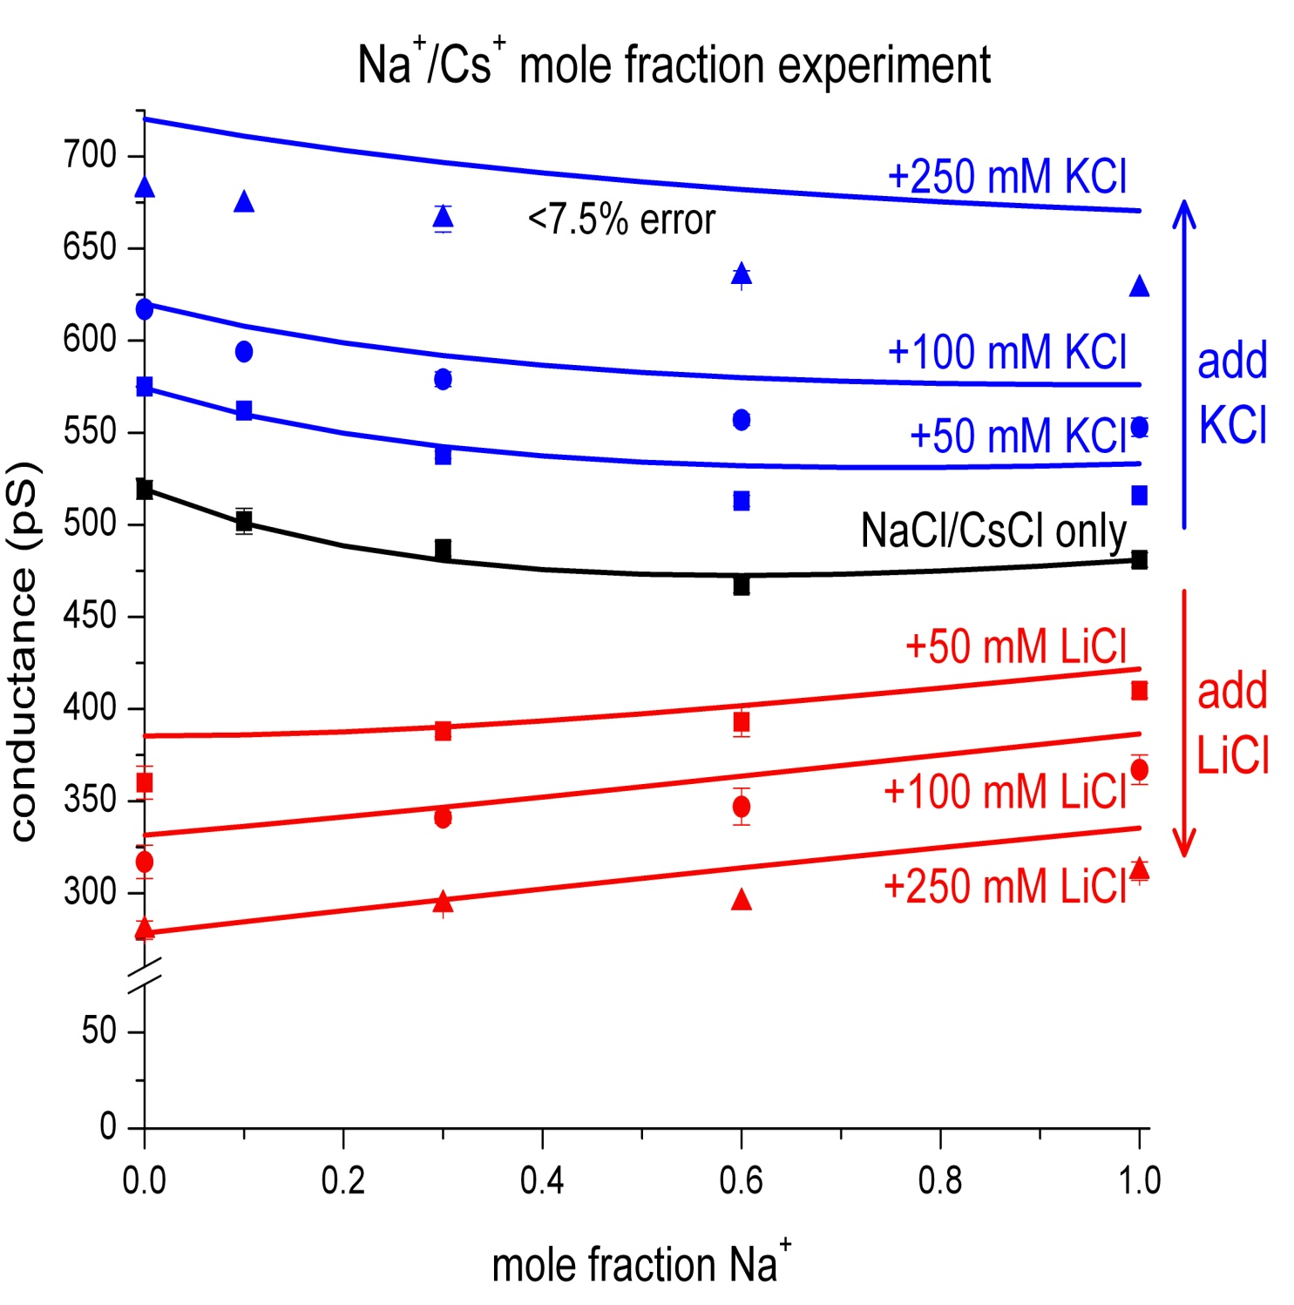
The model predicted that AMFE disappears
The Na⁺/Cs⁺ mole fraction experiment is repeated with varying amounts of KCl and LiCl present in addition to the NaCl and CsCl.
The model predicted that the AMFE disappears when other cations are present. This was later confirmed by experiment.
Prediction made without any adjustable parameters.
^{Note Break in Axis}
Error < 0.1 kT/e
Gillespie, Meissner, Le Xu, et al

Slide 50
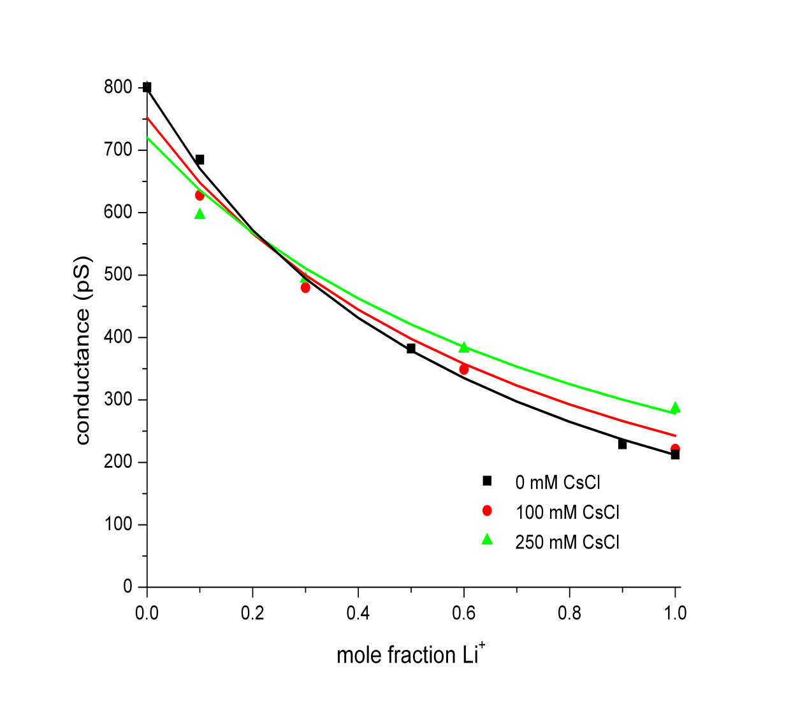
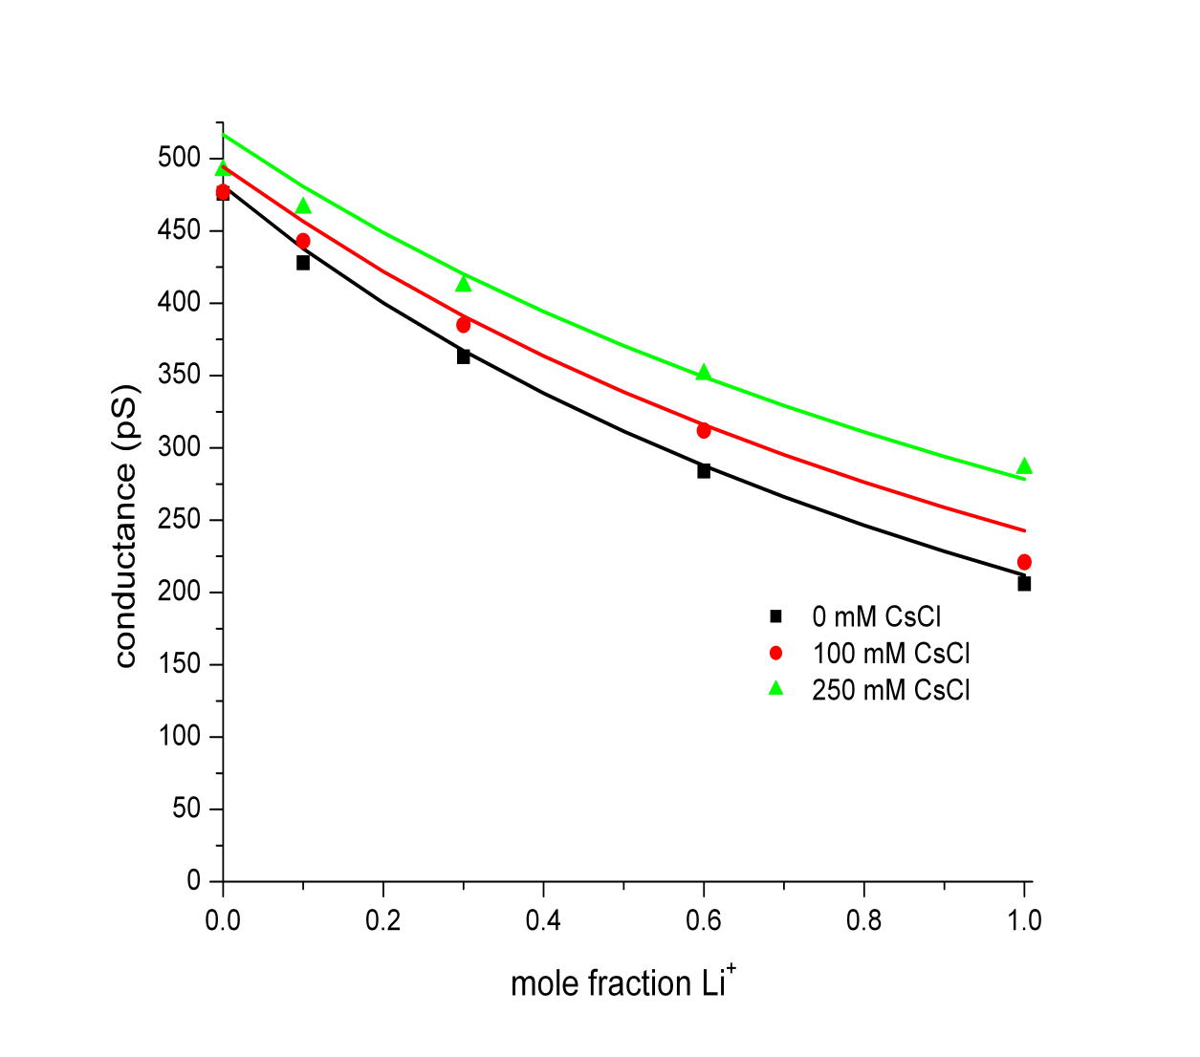
Mixtures of THREE Ions
The model reproduced the competition of cations for the pore without any adjustable parameters.
Gillespie, Meissner, Le Xu, et al
Li⁺ & K⁺ & Cs⁺
Li⁺ & Na⁺ & Cs⁺
Error < 0.1 kT/e

Slide 51
Selectivity comes from Electrostatic Interaction and Steric Competition for Space
Repulsion
Location and Strength of Binding Sites Depend on Ionic Concentration and Temperature, etc Rate Constants are Variables

Slide 52
Evidence
(end)

Slide 53
Evidence
Calcium Ca_{V} and Sodium Na_{V} Channel
(end)

Slide 54
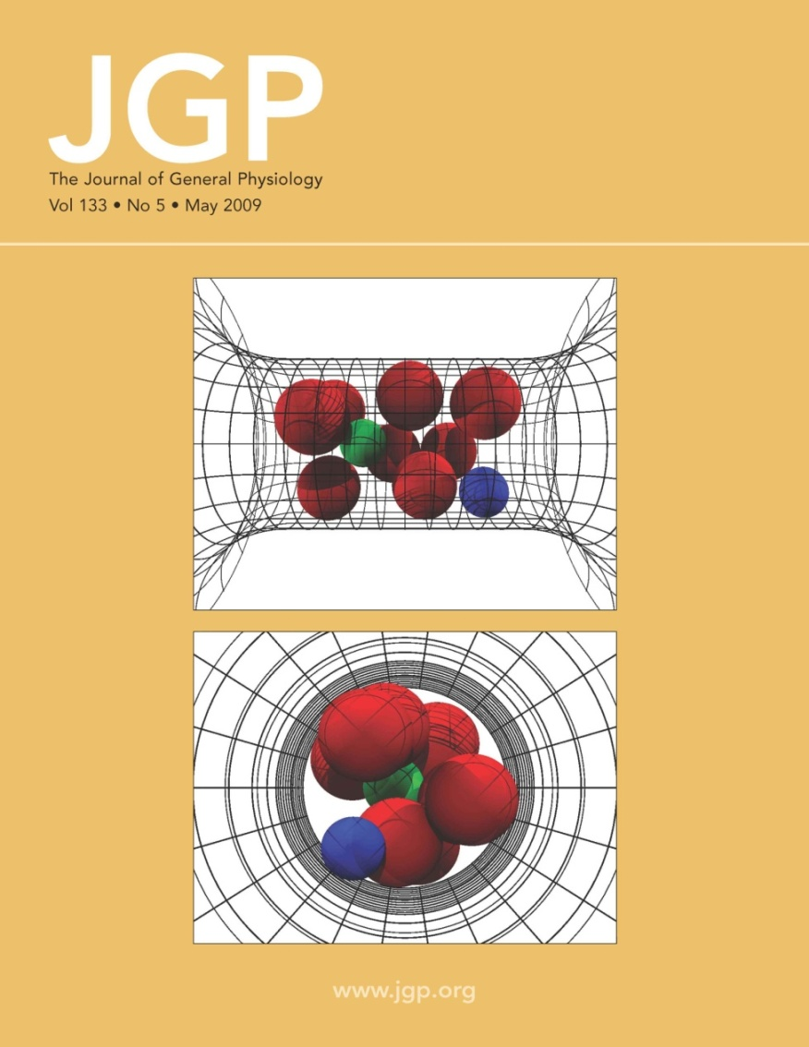
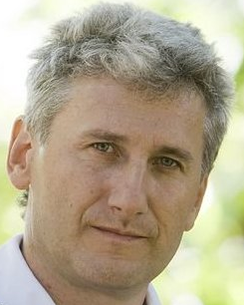
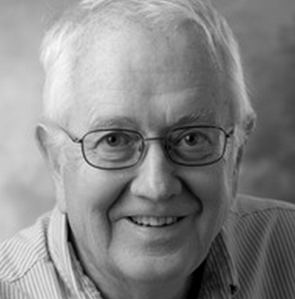
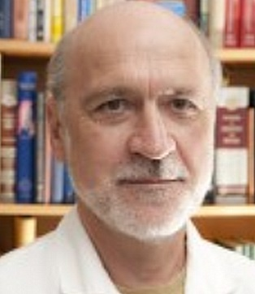
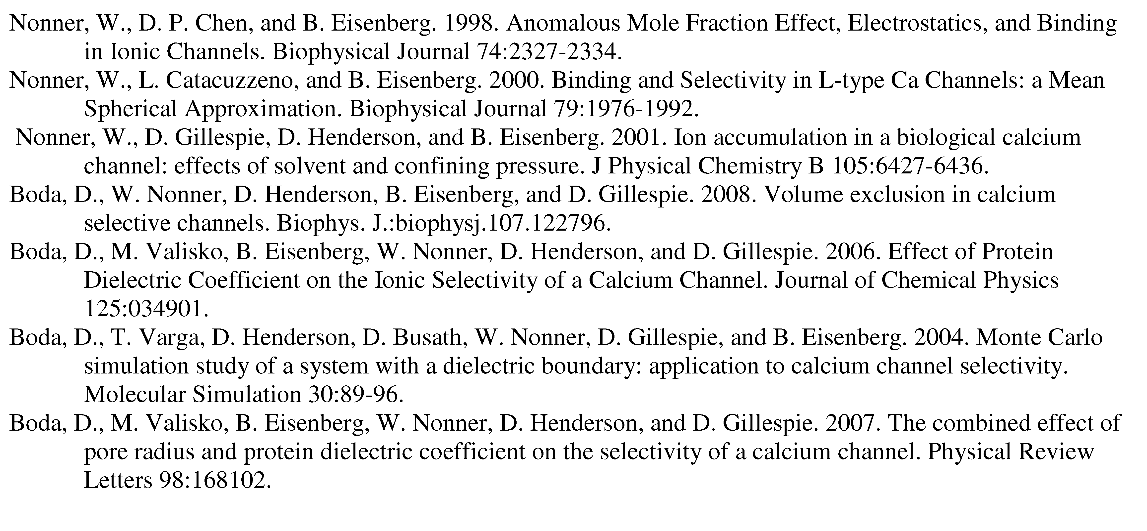
Calcium Channel of the Heart
Dezső Boda
Doug Henderson
Wolfgang Nonner
More than 35 papers are available at
ftp://ftp.rush.edu/users/molebio/Bob_Eisenberg/reprints

Slide 55
Mutation
Na Channel
Ca Channel
Same Parameters
E
E
E
A
D
E
K
A
Charge -3e
Charge -1e
1
0.004
Na⁺
Ca²⁺
Na⁺
Occupancy (number)
0.002
0.5
Ca²⁺
0
0
-6
-4
-2
0
0.05
0.1
log (Concentration/M)
Concentration/M
EEEE has full biological selectivity ^{in similar simulations}
Boda, et al

Slide 56
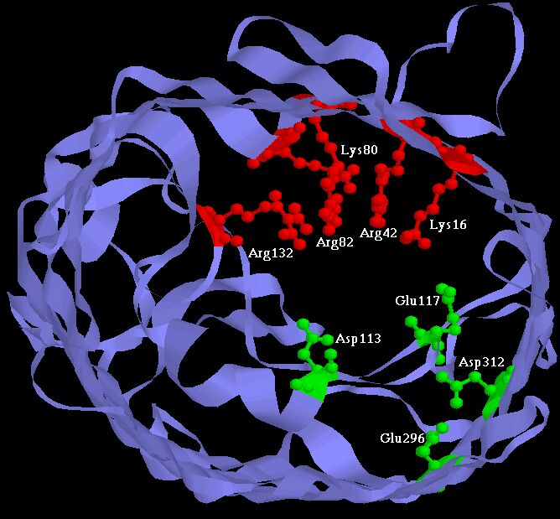
Experiments have ‘engineered’ channels (5 papers) including Two Synthetic Calcium Channels
Atomic Scale
Mutants of ompF Porin
Designed by Theory
Glutathione derivatives
MUTANT ─ Compound
Evidence
RyR
(start)
Calcium selective
Unselective
Natural ‘wild’ Type
As density of permanent charge increases, channel becomes calcium selective E_{rev} → E_{Ca} in 0.1M 1.0 M CaCl₂ ; pH 8.0
Macro Scale
||
built by Henk Miedema, Wim Meijberg of BioMade Corp. Groningen, Netherlands
Miedema et al, Biophys J 87: 3137–3147 (2004); 90:1202-1211 (2006); 91:4392-4400 (2006)

Slide 57
large mechanical forces

Slide 58
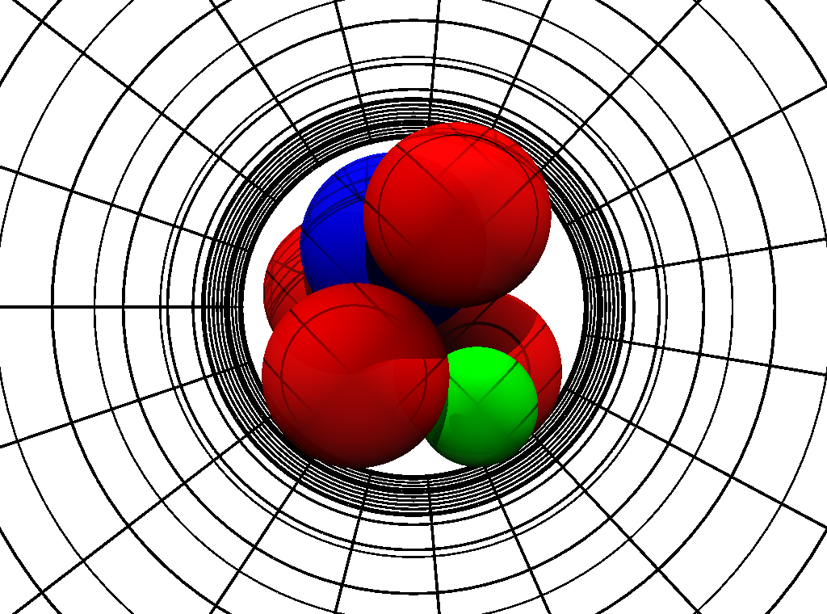
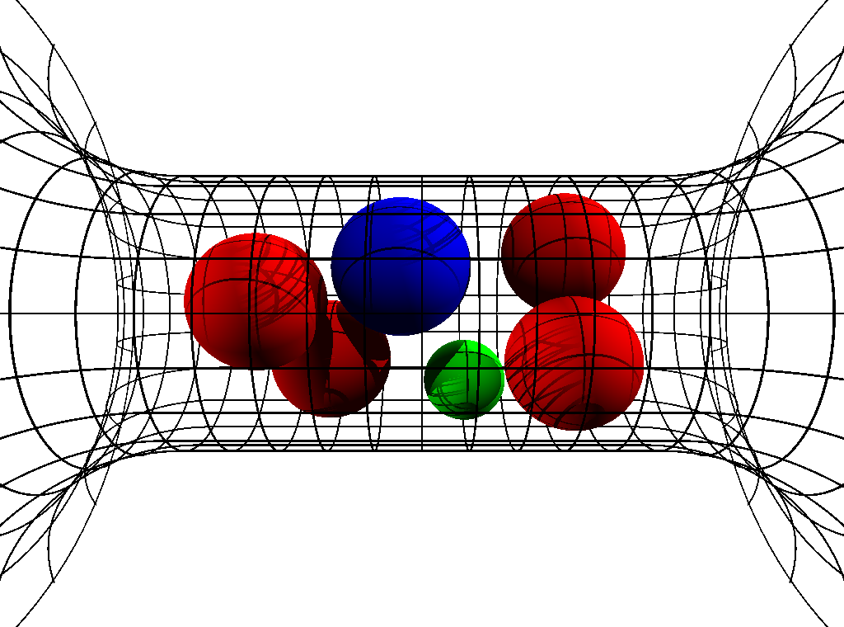
Crowded Ions
Radial Crowding is Severe
Ion Diameters ‘Pauling’ Diameters
Ca⁺⁺ | 1.98 Å
Na⁺ | 2.00 Å
K⁺ | 2.66 Å
‘Side Chain’ Diameter
Lysine K | 3.00 Å
D or E | 2.80 Å
Channel Diameter 6 Å
6Å
Snap Shots of Contents
Parameters are Fixed in all calculations in all solutions for all mutants
‘Side Chains’ are Spheres Free to move inside channel
Experiments and Calculations done at pH 8
Boda, Nonner, Valisko, Henderson, Eisenberg & Gillespie

Slide 59
Solved with Metropolis Monte Carlo MMC Simulates Location of Ions both the mean and the variance
Produces Equilibrium Distribution
of location
of Ions and ‘Side Chains’
MMC yields Boltzmann Distribution with correct Energy, Entropy and Free Energy
Other methods give nearly identical results
DFT (Density Functional Theory of fluids, not electrons)
DFT-PNP (Poisson Nernst Planck)
MSA (Mean Spherical Approximation)
SPM (Primitive Solvent Model)
EnVarA (Energy Variational Approach)
Non-equil MMC (Boda, Gillespie) several forms
Steric PNP (simplified EnVarA)
Poisson Fermi

Slide 60
Metropolis Monte Carlo Simulates Location of Ions both the mean and the variance
MMC details
Start with Configuration A, with computed energy E_{A}
Move an ion to location B, with computed energy E_{B}
If spheres overlap, E_{B} → ∞ and configuration is rejected
If spheres do not overlap, E_{B} ≠ 0 and configuration may be accepted
(4.1) If E_{B} < E_{A} : accept new configuration.
(4.2) If E_{B} > E_{A} : accept new configuration with Boltzmann probability
Key Idea produces enormous improvement in efficiency
MMC chooses configurations with Boltzmann probability and weights them evenly, instead of choosing from uniform distribution and weighting them with Boltzmann probability.

Slide 61
Sodium Channel Voltage controlled channel responsible for signaling in nerve and coordination of muscle contraction

Slide 62
Challenge
from channologists
Walter Stühmer and Stefan Heinemann
Göttingen Leipzig Max Planck Institutes
Can THEORY explain the MUTATION Calcium Channel into Sodium Channel?
DEEA DEKA
Calcium Channel
Sodium Channel

Slide 63
Mutation
Na Channel
Ca Channel
Same Parameters
E
E
E
A
D
E
K
A
Charge -3e
Charge -1e
1
0.004
Na⁺
Ca²⁺
Mutation
Na⁺
Occupancy (number)
0.002
0.5
Same Parameters pH 8
Ca²⁺
0
0
-6
-4
-2
0
0.05
0.1
log (Concentration/M)
Concentration/M pH =8
EEEE has full biological selectivity ^{in similar simulations}
Monte Carlo simulations of Boda, et al

Slide 64
Nothing was Changed from the EEEA Ca channel except the amino acids
Calculated DEKA Na Channel Selects Ca ²⁺ vs. Na ⁺ and also K⁺ vs. Na⁺
Calculations and experiments done at pH 8

Slide 65
How? Usually Complex Unsatisfying Answers* How does a Channel Select Na⁺ vs. K⁺ ? * Gillespie, D., Energetics of divalent selectivity in the ryanodine receptor. Biophys J (2008). 94: p. 1169-1184 * Boda, et al, Analyzing free-energy by Widom's particle insertion method. J Chem Phys (2011) 134: p. 055102-14
Calculations and experiments done at pH 8

Slide 66

Size Selectivity is in the Depletion Zone
Na⁺ vs. K⁺ Occupancy
Binding Sites NOT SELECTIVE
Channel Protein
Na⁺
[NaCl] = 50 mM [KCl] = 50 mM pH 8
K⁺
Concentration [Molar]
Selectivity Filter
K⁺
Na⁺
Na Selectivity because 0 K⁺ in Depletion Zone
Depletion Zone
of the DEKA Na Channel, 6 Å
Boda, et al

Slide 67
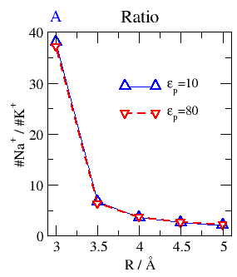
Na⁺ vs K⁺ (size) Selectivity (ratio) Depends on Channel Size, not dehydration (not on Protein Dielectric Coefficient)*
Selectivity
for small ion
Na⁺
2.00 Å
K⁺
Na⁺
K⁺
2.66 Å
6 8 10
Small Channel Diameter Large in Å
Boda, et al
*in DEKA Na channel

Slide 68
Simple Independent§ Control Variables* DEKA Na⁺ channel
Amazingly simple, not complex
for the most important selectivity property
of DEKA Na⁺ channels
*Control variable = position of gas pedal or dimmer on light switch
§ Gas pedal and brake pedal are (hopefully) independent control variables
Boda, et al

Slide 69
(1) Structure and (2) Dehydration/Re-solvation emerge from calculations Structure (diameter) controls Selectivity Solvation (dielectric) controls Contents *Control variables emerge as outputs Control variables are not inputs
Independent Control Variables*
Dielectric constants
Diameter

Slide 70
Structure (diameter) controls Selectivity Solvation (dielectric) controls Contents Control Variables emerge as outputs Control Variables are not inputs Monte Carlo calculations of the DEKA Na channel

Slide 71
Evidence
Calcium Ca_{V} and Sodium Na_{V} Channel
(end)

Slide 72
Where to start?
Why not Compute all the atoms?

Slide 73
^{Multi-Scale Issues}
Journal of Physical Chemistry C (2010 )114:20719
Computational Scale | Biological Scale | Ratio
Time 10⁻¹⁵ sec | 10⁻⁴ sec | 10¹¹
Length 10⁻¹¹ m | 10⁻⁵ m | 10⁶
DEVICES DEPEND ON FINE TOLERANCES
parts must fit
Atomic and Macro Scales are BOTH used by channels because they are nanovalves
so atomic and macro scales must be
Computed and CALIBRATED Together
This may be impossible in all-atom simulations

Slide 74
^{Multi-Scale Issues}
Journal of Physical Chemistry C (2010 )114:20719
Computational Scale | Biological Scale | Ratio
Spatial Resolution |  | 10¹²
Volume 10⁻³⁰ m³ | (10⁻⁴ m)³ = 10⁻¹² m³ | 10¹⁸
Three Dimensional (10⁴)³
DEVICES DEPEND ON FINE TOLERANCES
parts must fit
Atomic and Macro Scales are BOTH used by channels because they are nanovalves
so atomic and macro scales must be
Computed and CALIBRATED Together
This may be impossible in all-atom simulations

Slide 75
^{Multi-Scale Issues}
Journal of Physical Chemistry C (2010 )114:20719
Computational Scale | Biological Scale | Ratio
Solute Concentration including Ca²⁺mixtures | 10⁻¹¹ to 10¹ M | 10¹²
DEVICES DEPEND ON FINE TOLERANCES
parts must fit
so atomic and macro scales must be
Computed and CALIBRATED Together
This may be impossible in all-atom simulations

Slide 76
All Life Occurs in Ionic Mixtures
in which [Ca²⁺] is important* as a control signal
Simulations must deal with
Multiple Components as well as
Multiple Scales
This may be nearly impossible for ionic mixtures
because
‘everything’ interacts with ‘everything else’
on both atomic and macroscopic scales
particularly when mixtures flow
*[Ca²⁺] ranges from 1×10⁻⁸ M inside cells to 10 M inside channels

Slide 77
^{Multi-Scale Issues}
Journal of Physical Chemistry C (2010 )114:20719
DEVICES DEPEND ON FINE TOLERANCES
parts must fit
Atomic and Macro Scales are BOTH used by channels because they are nanovalves
so atomic and macro scales must be
Computed and CALIBRATED Together
This may be impossible in all-atom simulations

Slide 78
Physics Today 58:35
*
Calibration!
*not so new, really, just unpleasant

Slide 79
Uncalibrated Simulations will make devices that do not work
Details matter in devices

Slide 80
Physical Chemists are Frustrated by Real Solutions

Slide 81
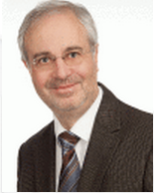
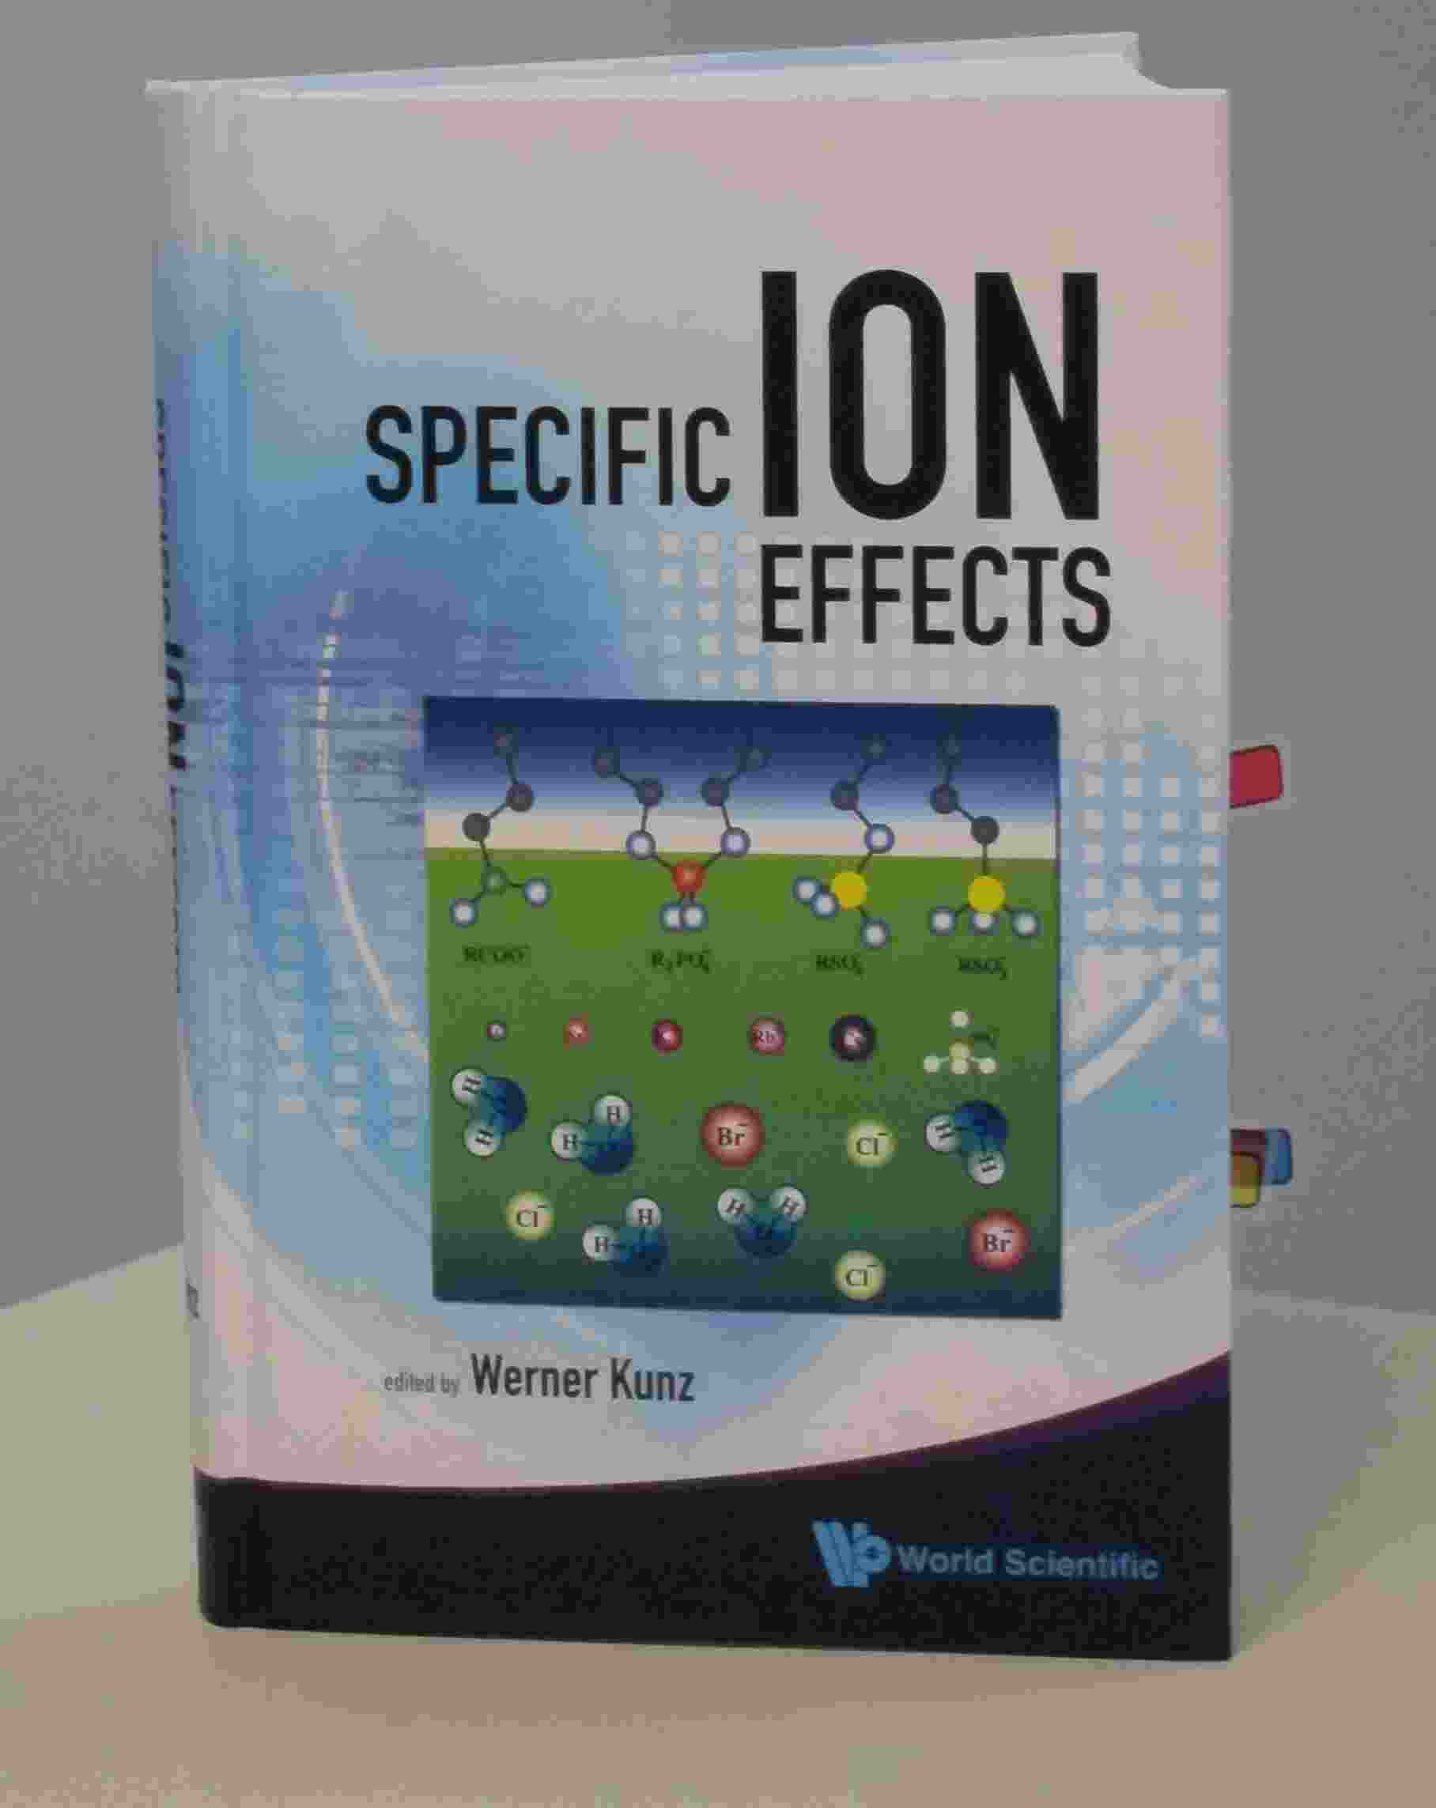
Werner Kunz
“It is still a fact that over the last decades, it was easier to fly to the moon than to describe the free energy of even the simplest salt solutions beyond a concentration of 0.1M or so.”
Kunz, W. "Specific Ion Effects"
World Scientific Singapore, 2009; p 11.

Slide 82
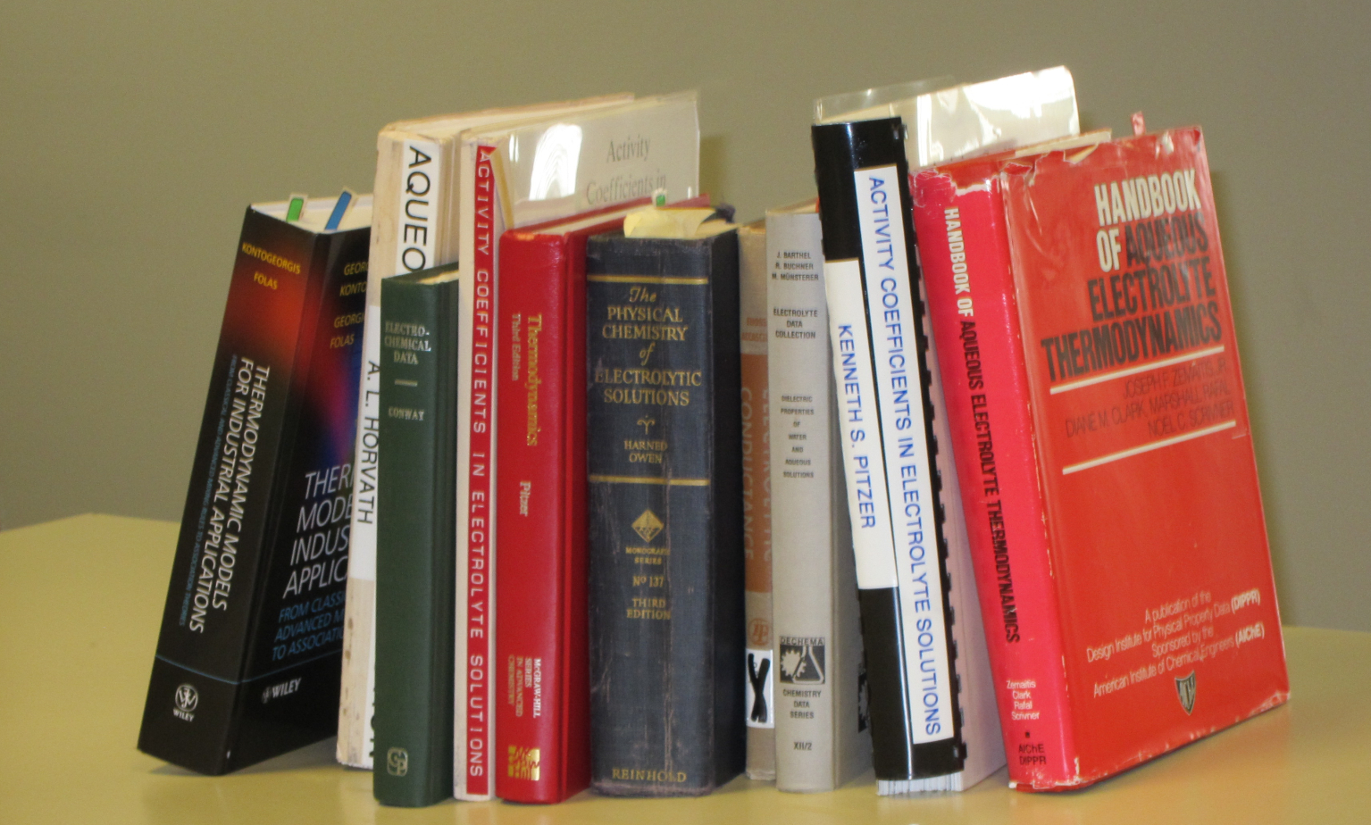
Good Data

Slide 83
Good Data
Compilations of Specific Ion Effect
>139,175 Data Points [Sept 2011] on-line IVC-SEP Tech Univ of Denmark http://www.cere.dtu.dk/Expertise/Data_Bank.aspx
2. Kontogeorgis, G. and G. Folas, 2009: Models for Electrolyte Systems. Thermodynamic John Wiley & Sons, Ltd. 461-523.
3. Zemaitis, J.F., Jr., D.M. Clark, M. Rafal, and N.C. Scrivner, 1986, Handbook of Aqueous Electrolyte Thermodynamics.
American Institute of Chemical Engineers
4. Pytkowicz, R.M., 1979, Activity Coefficients in Electrolyte Solutions. Vol. 1. Boca Raton FL USA: CRC. 288.

Slide 84
The classical text of Robinson and Stokes (not otherwise noted for its emotional content) gives a glimpse of these feelings when it says “In regard to concentrated solutions, many workers adopt a counsel of despair, confining their interest to concentrations below about 0.02 M, ... ” p. 302 Electrolyte Solutions (1959) Butterworths , also Dover (2002)

Slide 85
“Poisson Boltzmann theories are restricted to such low concentrations that the solutions cannot be studied in the laboratory”
slight paraphrase of p. 125 of Barthel, Krienke, and Kunz Kunz, Springer, 1998
Original text “… experimental verification often proves to be an unsolvable task”

Slide 86
Valves Control Flow
Classical Theory & Simulations NOT designed for flow
Thermodynamics, Statistical Mechanics do not allow flow
Rate Models do not Conserve Current
if rate constants are constant or even if
rates are functions of local potential

Slide 87
‘All Spheres’ Model
Side Chains are Spheres
Channel is a Cylinder
Side Chains are free to move within Cylinder
Ions and Side Chains are at free energy minimum
i.e., ions and side chains are ‘self organized’,
‘Binding Site” is induced by substrate ions
Nonner & Eisenberg

Slide 88
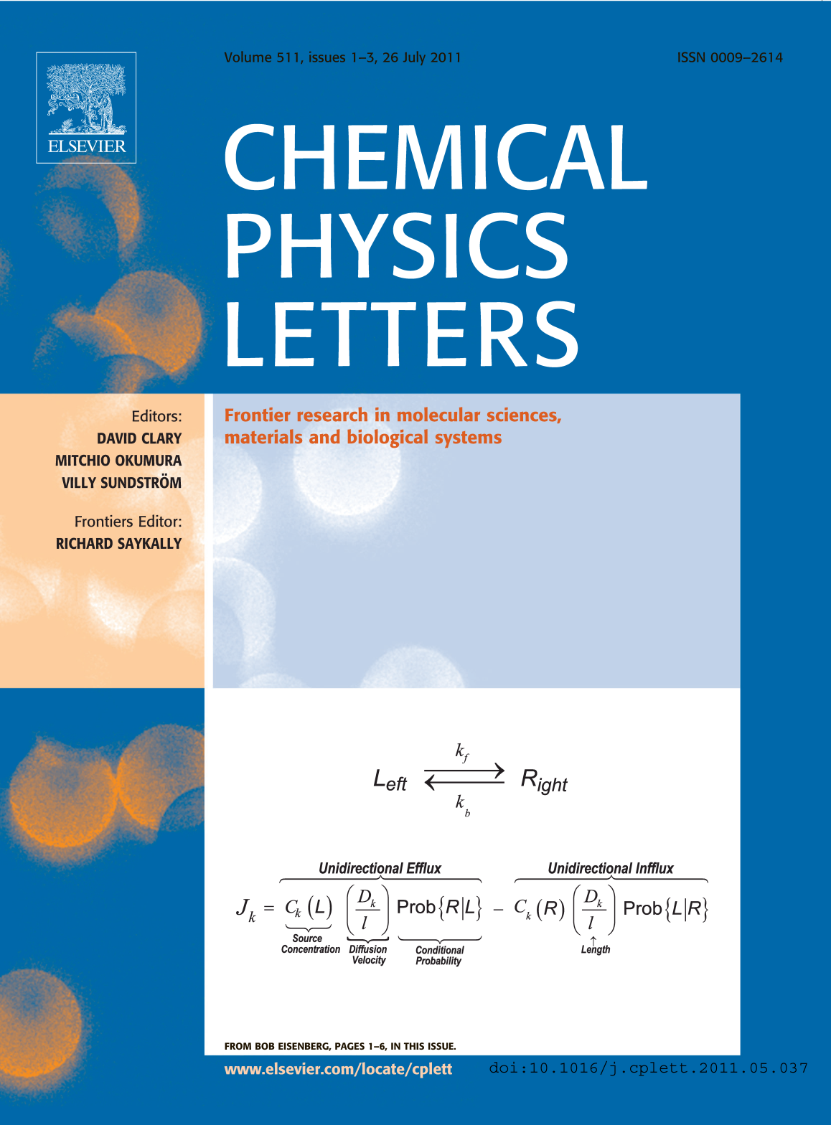
Variational Approach
EnVarA
‘Law’ of Mass Action including Interactions
Conservative
Dissipative
From Bob Eisenberg p. 1-6, in this issue

Slide 89
Energetic Variational Approach EnVarA Chun Liu, Rolf Ryham, and Yunkyong Hyon
Mathematicians and Modelers: two different ‘partial’ variations
written in one framework, using a ‘pullback’ of the action integral
Shorthand for Euler Lagrange process
with respect to
Shorthand for Euler Lagrange process
with respect to
Action Integral, after pullback
Rayleigh Dissipation Function
Composite Variational Principle
Euler Lagrange Equations
Field Theory of Ionic Solutions: Liu, Ryham, Hyon, Eisenberg
Allows boundary conditions and flow Deals Consistently with Interactions of Components

Slide 90
Dissipation Principle Conservative Energy dissipates into Friction
Number Density
time
Permanent Charge of protein
Hard Sphere Terms
Thermal Energy
valence
proton charge
c_{i} number density; thermal energy; D_{i} diffusion coefficient; n negative; p positive; z_{i} valence; ε dielectric constant
Note that
with suitable boundary conditions

Slide 91
Energetic Variational Approach EnVarA
is defined by the Euler Lagrange Process,
as I understand the pure math from Craig Evans
which gives Equations like PNP
BUT
I leave it to you (all)
to argue/discuss with Craig about the purity of the process when two variations are involved

Slide 92
PNP (Poisson Nernst Planck) for Spheres
Non-equilibrium variational field theory EnVarA
Nernst Planck Diffusion Equation
for number density c_{n} of negative n ions; positive ions are analogous
Diffusion Coefficient
Thermal Energy
Coupling Parameters
Ion Radii
Number Densities
Poisson Equation
Dielectric Coefficient
valence
proton charge
Eisenberg, Hyon, and Liu
Permanent Charge of Protein

Slide 93
All we have to do is Solve it / them! with boundary conditions defining Charge Carriers ions, holes, quasi-electrons Geometry

Slide 94
Biology and Semiconductors share a very similar Reduced Model PNP of various flavors

Slide 95
Semiconductor Technology
like biology
is all about Dimensional Reduction
to a
Reduced Model
of a
Device

Slide 96
Semiconductor PNP Equations For Point Charges
Dielectric Coefficient
Poisson’s Equation
Permanent Charge of Protein
Valence
Proton charge
Cross sectional Area
Drift-diffusion & Continuity Equation
Number Densities
Flux
Diffusion Coefficient
Chemical Potential
Not in Semiconductor
valence
proton charge
Thermal Energy

Slide 97
Boundary conditions: STRUCTURES of Ion Channels STRUCTURES of semiconductor devices and integrated circuits
All we have to do is Solve it / them!

Slide 98
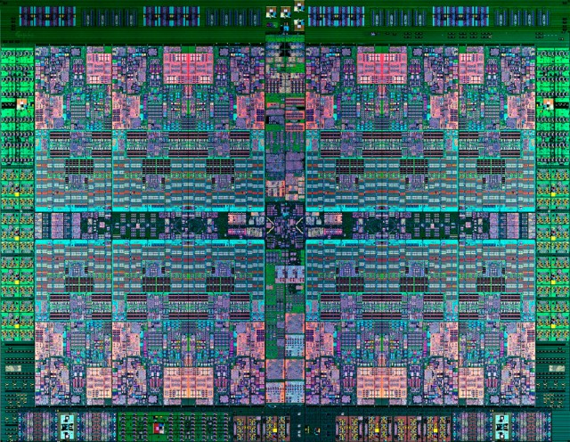
Integrated Circuit Technology as of ~2014 IBM Power8
Too small to see!

Slide 99
Semiconductor Devices
PNP equations describe many robust input output relations
Amplifier
Limiter
Switch
Multiplier
Logarithmic convertor
Exponential convertor
These are SOLUTIONS of PNP for different boundary conditions
with ONE SET of CONSTITUTIVE PARAMETERS PNP of POINTS is TRANSFERRABLE Analytical - Numerical Analysis
should be attempted using techniques of Weishi Liu University of Kansas Tai-Chia Lin National Taiwan University & Chun Liu PSU

Slide 100
Learn from
Mathematics of Ion Channels
solving specific Inverse Problems
How does it work?
How do a few atoms control (macroscopic) Biological Devices

Slide 101
Biology is Easier than Physics
Reduced Models Exist*
for important biological functions
or the
Animal would not survive
to reproduce
*Evolution provides the existence theorems and uniqueness conditions so hard to find in theory of inverse problems. (Some biological systems − the human shoulder − are not robust, probably because they are incompletely evolved, i.e they are in a local minimum ‘in fitness landscape’ . I do not know how to analyze these. I can only describe them in the classical biological tradition.)

Slide 102
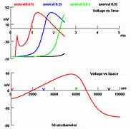
Propagation of Action Potential

Slide 103
Multi-scale Engineering is MUCH easier when robust
Reduced Models Exist

Slide 104
Reduced models exist because they are the Adaptation created by evolution to perform a biological function like selectivity
Reduced Models
and its parameters
are found by Inverse Methods

Slide 105
The Reduced Equation is
How it works!
Multiscale Reduced Equation Shows how a Few Atoms Control Biological Function

Slide 106
This kind of Dimensional Reduction is an
Inverse Problem
where the essential issues are Robustness
Sensitivity
Non-uniqueness

Slide 107
Ill posed problems with too little data Seem Complex even if they are not
Some of Biology is Simple

Slide 108
Ill posed problems with too little data Seem Complex even if they are not
Some of biology seems complex
only because data is inadequate
Some* of biology is
amazingly
Simple
ATP as UNIVERSAL energy source
*The question is which ‘some’?
PS: Some of biology IS complex

Slide 109
Bioengineers: this is reverse engineering
Inverse Problems
Find the Model, given the Output Many answers are possible: ‘ill posed’ * Central Issue
Which answer is right?
*Ill posed problems with too little data seem complex, even if they are not.
Some of biology seems complex for that reason.
The question is which ‘some’?

Slide 110
How does the Channel control Selectivity?
Inverse Problems: many answers possible
Central Issue
Which answer is right?
Key is
ALWAYS
Large Amount of Data
from
Many Different Conditions
Almost too much data was available for reduced model:
Burger, Eisenberg and Engl (2007) SIAM J Applied Math 67:960-989

Slide 111
Inverse Problems: many answers possible
Which answer is right?
Key is
Large Amount of Data from Many Different Conditions
Otherwise problem is ‘ill-posed’ and has no answer or even set of answers
Molecular Dynamics
usually yields
ONE data point
at one concentration
MD is not yet well calibrated (i.e., for activity = free energy per mole) for Ca²⁺ or ionic mixtures like seawater or biological solutions

Slide 112
Working Hypothesis:
Crucial Biological Adaptation is
Crowded Ions and Side Chains
Wise to use the Biological Adaptation
to make the reduced model!
Reduced Models allow much easier Atomic Scale Engineering

Slide 113
Working Hypothesis:
Crucial Biological Adaptation is
Crowded Ions and Side Chains
Biological Adaptation GUARANTEES stable
Robust, Insensitive Reduced Models
Biological Adaptation ‘solves’ the Inverse Problem

Slide 114
Working Hypothesis:
Biological Adaptation of Crowded Charge produces stable
Robust, Insensitive, Useful Reduced Models
Biological Adaptation Solves
the Inverse Problem
Provides Dimensional Reduction

Slide 115
Working Hypothesis:
Crowded Charge
enables
Dimensional Reduction
to a
Device Equation
which is How it Works

Slide 116
Physical basis of function
Active Sites of Proteins are Very Charged
7 charges ~ 20 M net charge
= 1.2×10²² cm⁻³
liquid Water is 55 M solid NaCl is 37 M
OmpF Porin
Ions are Crowded
Hard Spheres
Na⁺
+
+
+
+
+
K⁺
Ca²⁺
Na⁺
-
-
-
K⁺
-
Induced Fit of Side Chains
4 Å
Selectivity Filters and Gates of Ion Channels
are
Active Sites
Figure adapted from Tilman Schirmer

Slide 117
Crowded Active Sites in 573 Enzymes
Enzyme Type |  | Catalytic Active Site Density (Molar) |  |  | Protein
 |  | Acid (positive) | Basic (negative) | | Total | | Elsewhere
 | Total (n = 573) | 10.6 | 8.3 | 18.9 | 2.8
EC1 | Oxidoreductases (n = 98) | 7.5 | 4.6 | 12.1 | 2.8
EC2 | Transferases (n = 126) | 9.5 | 7.2 | 16.6 | 3.1
EC3 | Hydrolases (n = 214) | 12.1 | 10.7 | 22.8 | 2.7
EC4 | Lyases (n = 72) | 11.2 | 7.3 | 18.5 | 2.8
EC5 | Isomerases (n = 43) | 12.6 | 9.5 | 22.1 | 2.9
EC6 | Ligases (n = 20) | 9.7 | 8.3 | 18.0 | 3.0
Jimenez-Morales, Liang, Eisenberg

Slide 118
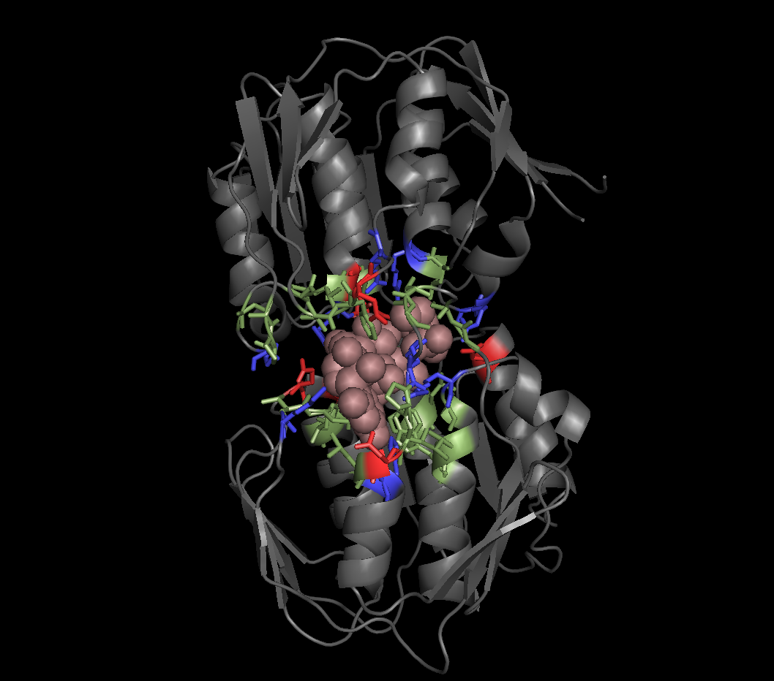
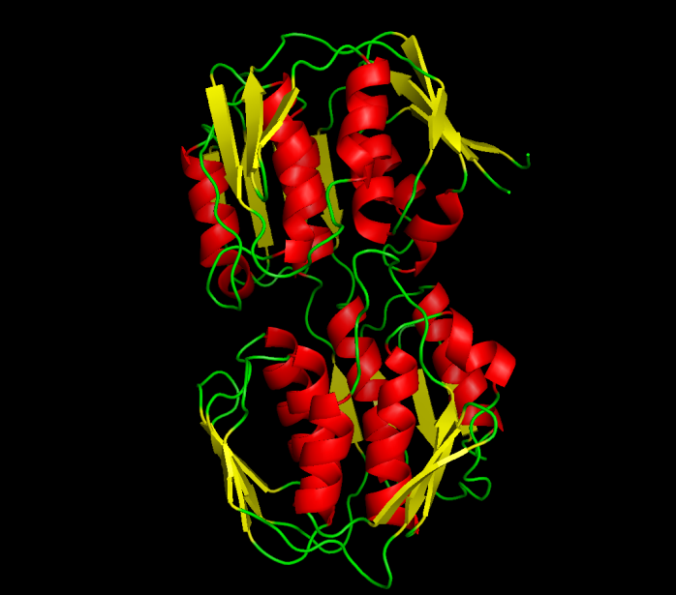
EC2: TRANSFERASES Average Ionizable Density: 19.8 Molar
Example
UDP-N-ACETYLGLUCOSAMINE ENOLPYRUVYL TRANSFERASE (PDB:1UAE)
Functional Pocket Volume: 1462.40 Å³
Density : 19.3 Molar (11.3 M+. 8 M-)
Crowded
Green: Functional pocket residues
Blue: Basic = Probably Positive = R+K+H
Red: Acid = Probably Negative = E + Q
Brown Uridine-Diphosphate-N-acetylclucosamine
Jimenez-Morales, Liang, Eisenberg

Slide 119
Take Home Lesson

Slide 120
Biological Adaptation
enables
Dimensional Reduction
to a
Device Equation
which is How it Works

Slide 121
Uncalibrated Simulations Vague and Difficult to Test

Slide 122
Uncalibrated Simulations lead to Interminable Argument and Interminable Investigation

Slide 123
thus, to Interminable Funding

Slide 124
and so
Uncalibrated Simulations Are Popular

Slide 125
The End
Any Questions?

